Slide 1
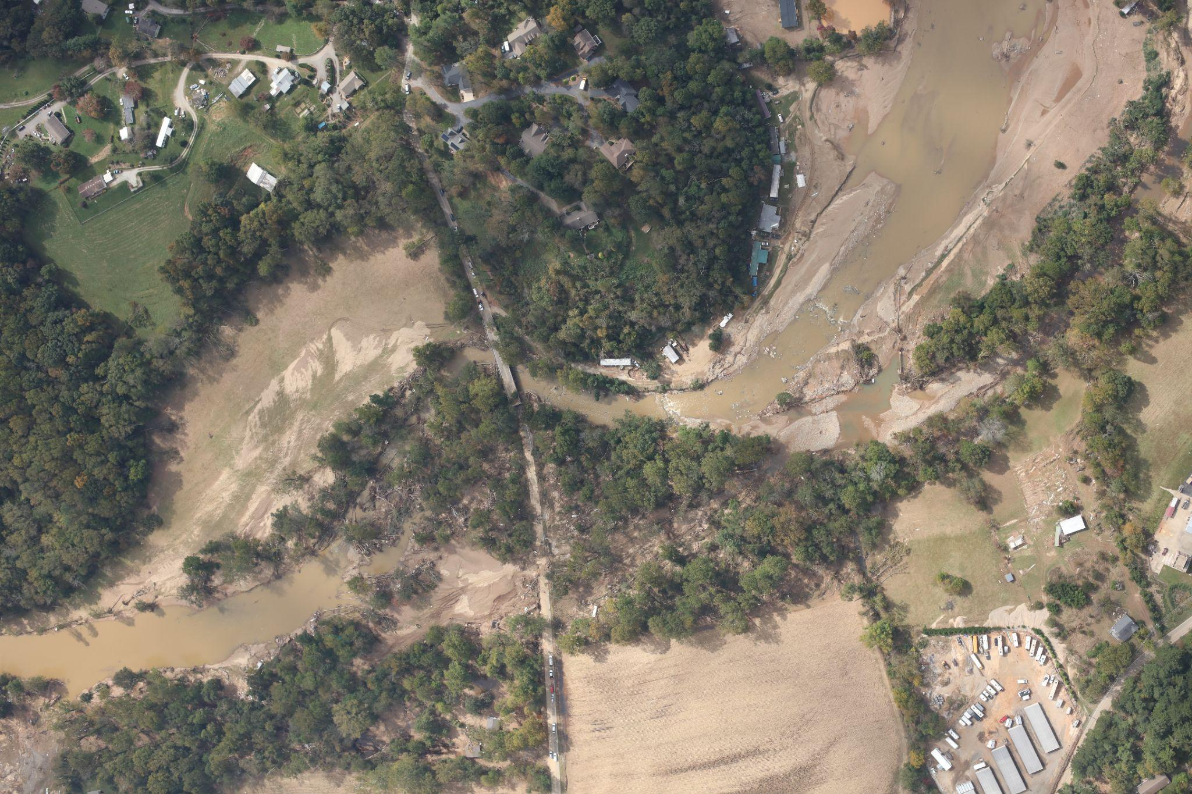





Topographic Impacts of
Hurricane Helene
in Western North Carolina
IALE-NA
April 16, 2025
Corey T. White, Pratikshya Regmi, William Reckling, Helena Mitasova

Slide 2
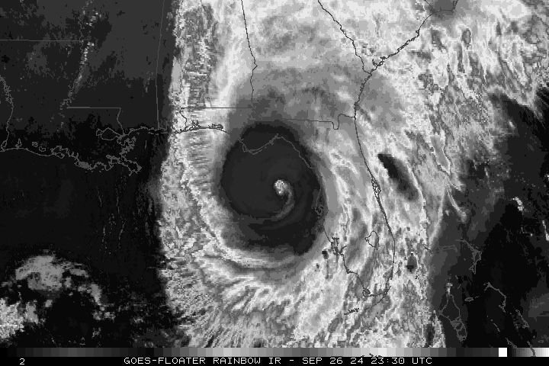
Hurricane Helene
Sept 24 - 27, 2024
Makes landfall off the Florida Coast
Category 4
Massive inland flooding
34 flash flood emergencies
~250 Fatalities
$78.8 billion dollars of
estimated damage
Hagen et al. 2025

Slide 3
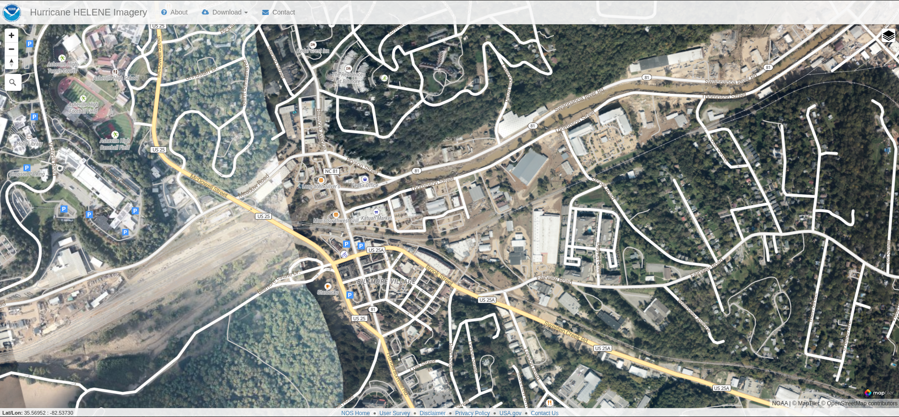
Imagery
https://storms.ngs.noaa.gov/storms/helene/index.html#15.42/35.568578/-82.540574

Slide 4
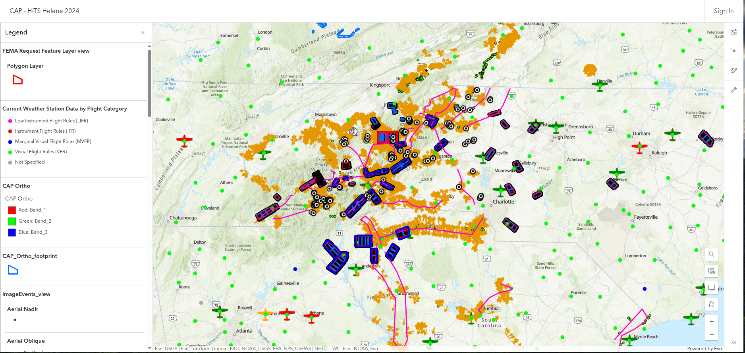
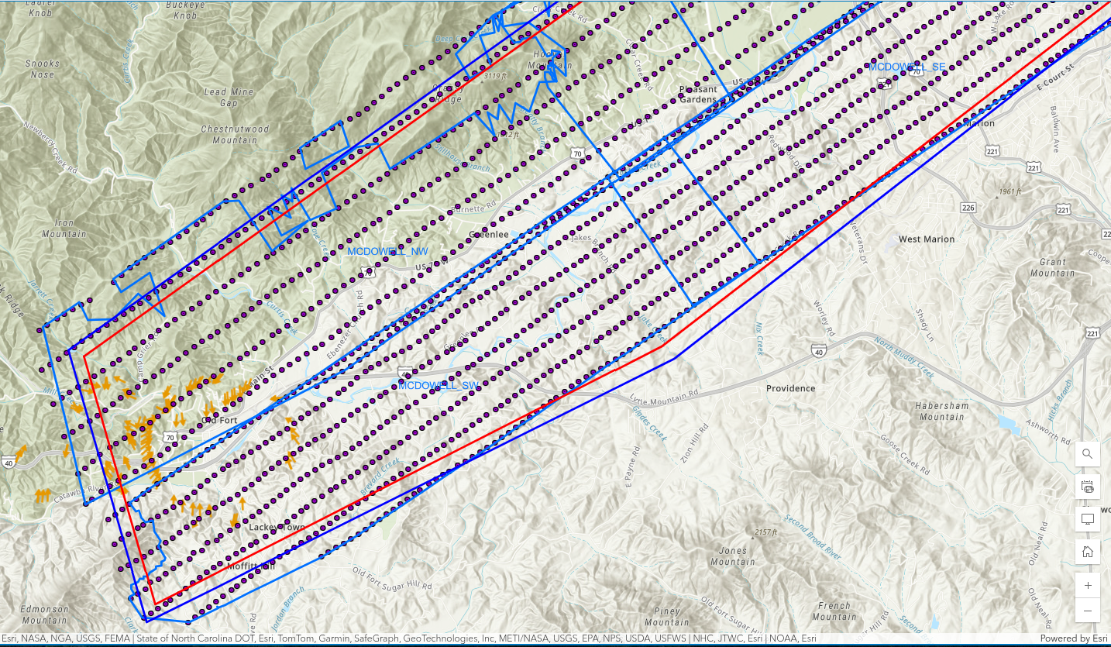
Imagery
Civil Air Patrol Flights
Takes aerial imagery after natural disasters
Satellite
Cloud cover or smoke can prevent clear imaging of impacted areas
UAS
Good for capturing smaller areas
Hard to capture areas that are unacceptable
Destroy road
Debris
Flight Vector Data: https://services.arcgis.com/XG15cJAlne2vxtgt/ArcGIS/rest/services/Image_Points_view/FeatureServer/3/query
Notes:
post-storm aerial imagery collected by the Civil Air Patrol (CAP) provided crucial early data for understanding the full range of topographic disturbances. We employed structure-from-motion (SfM) to process 69,247 CAP aerial images (~1.41 TB) into digital surface models (DSM)

Slide 5
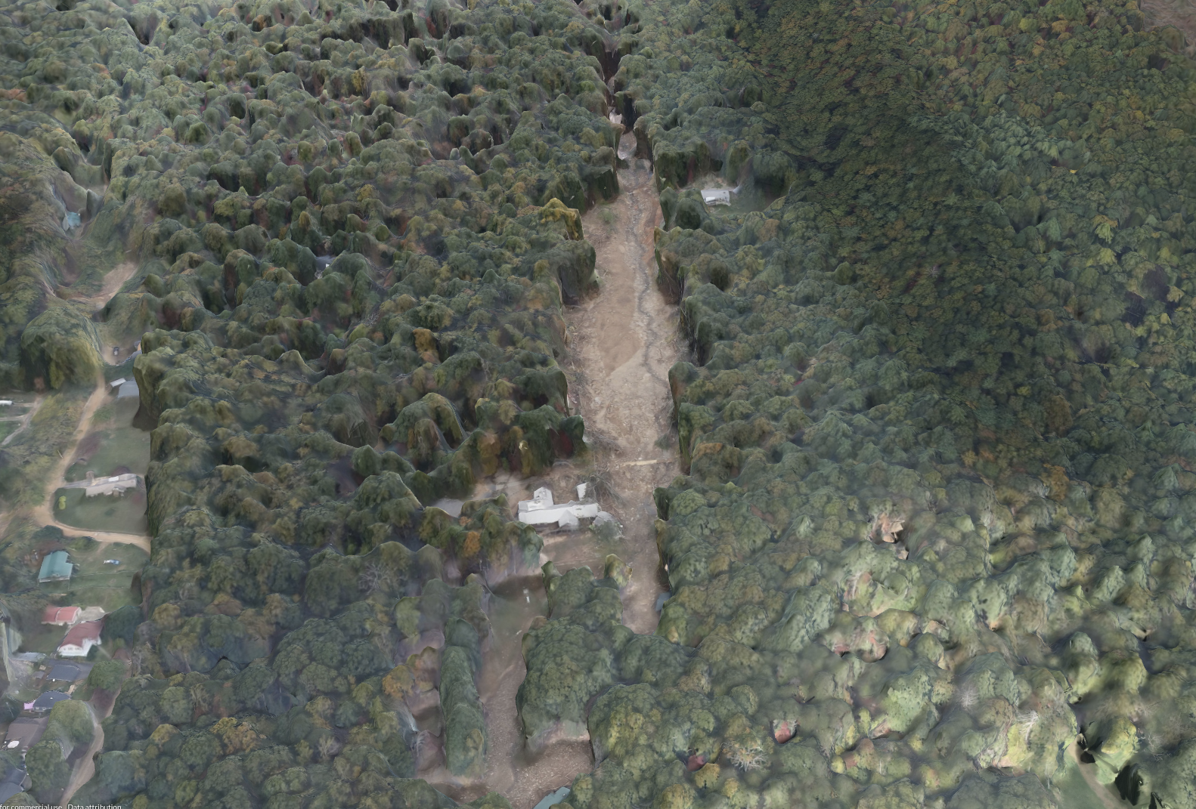
Topographic Products
Provide emergency managers with actionable insights by identifying
Location
Extent
Volume
To help estimate and prioritized resources to address
Structural Damages
Buildings
Bridges
Roads
Erosion and Deposition
Landslides

Slide 6
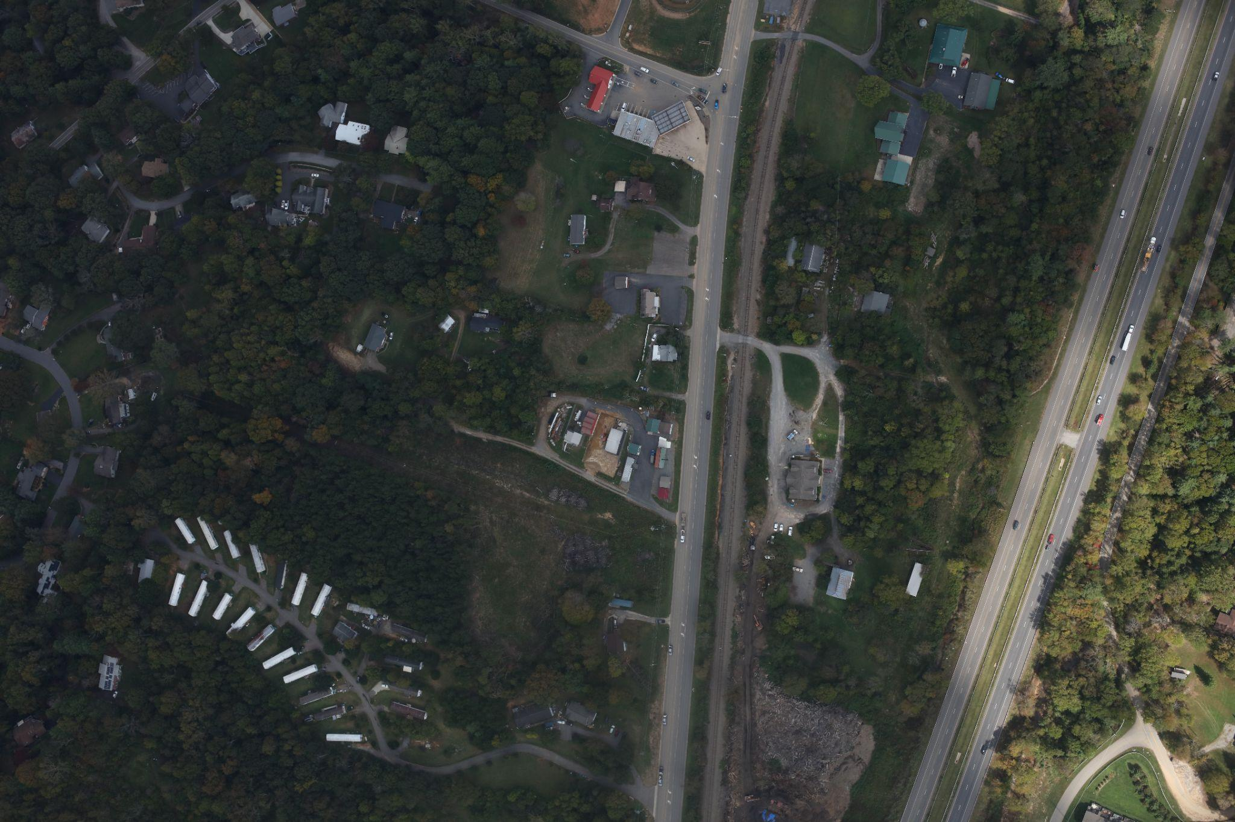
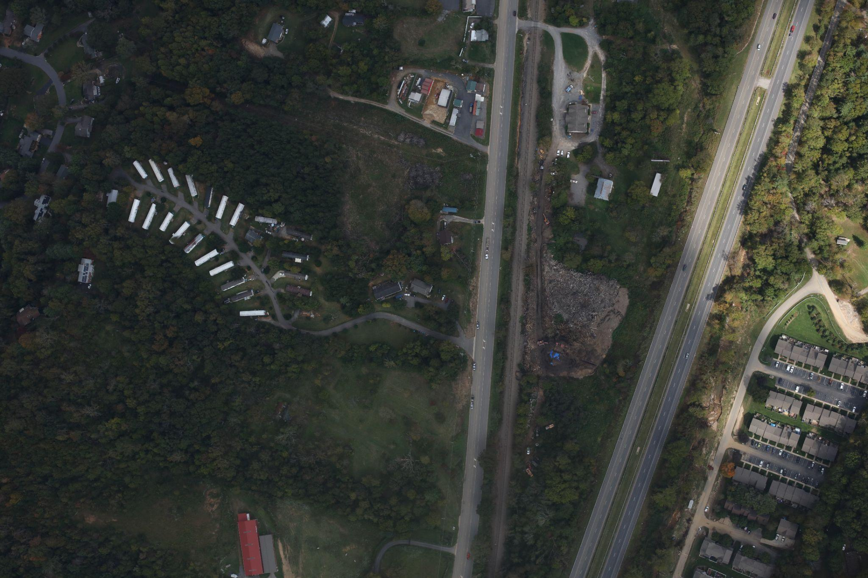
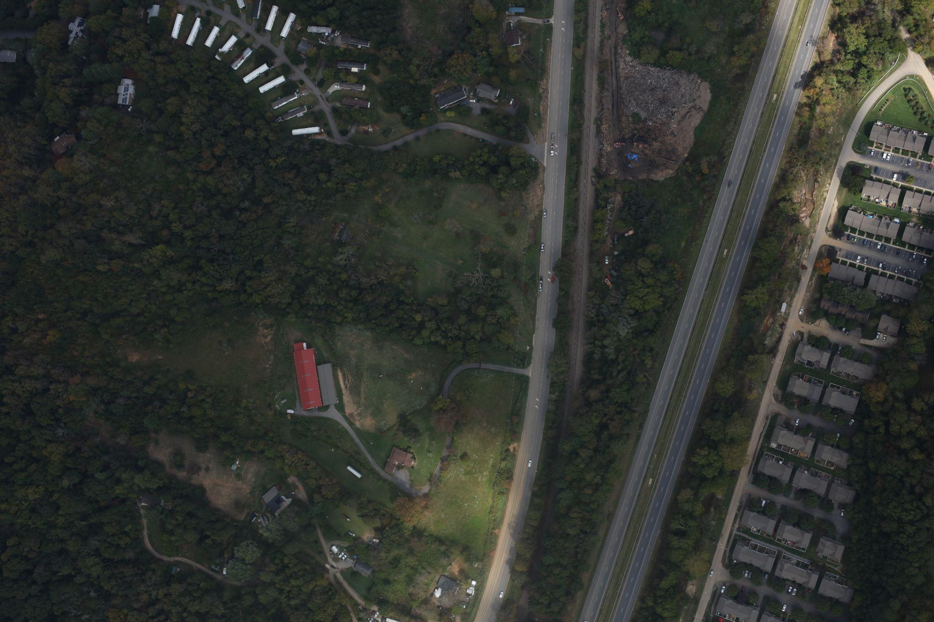
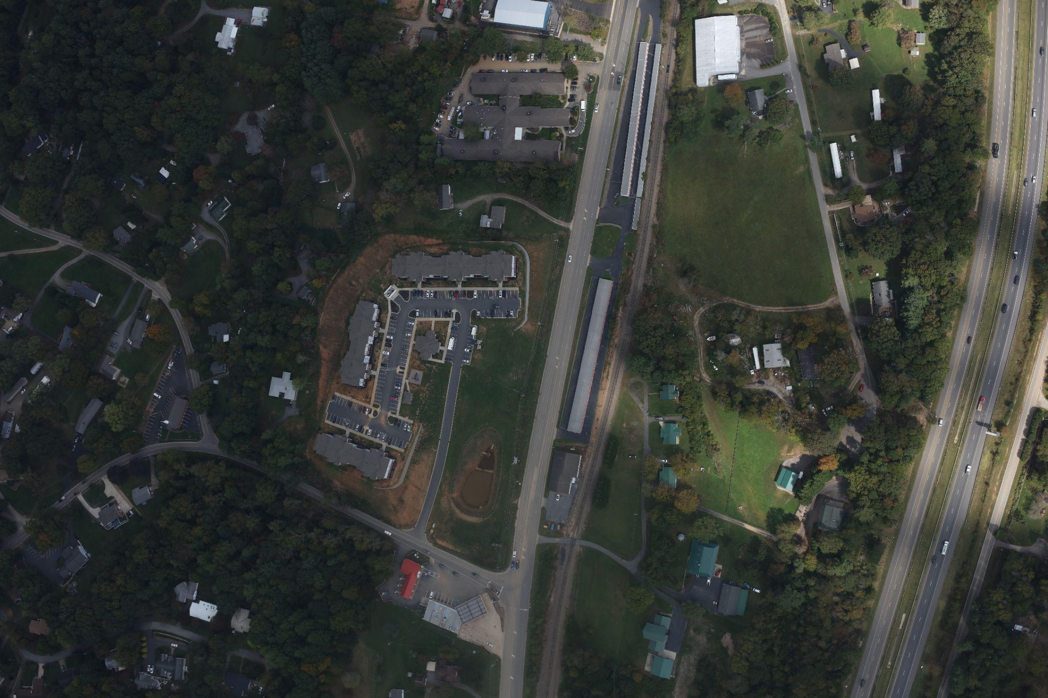
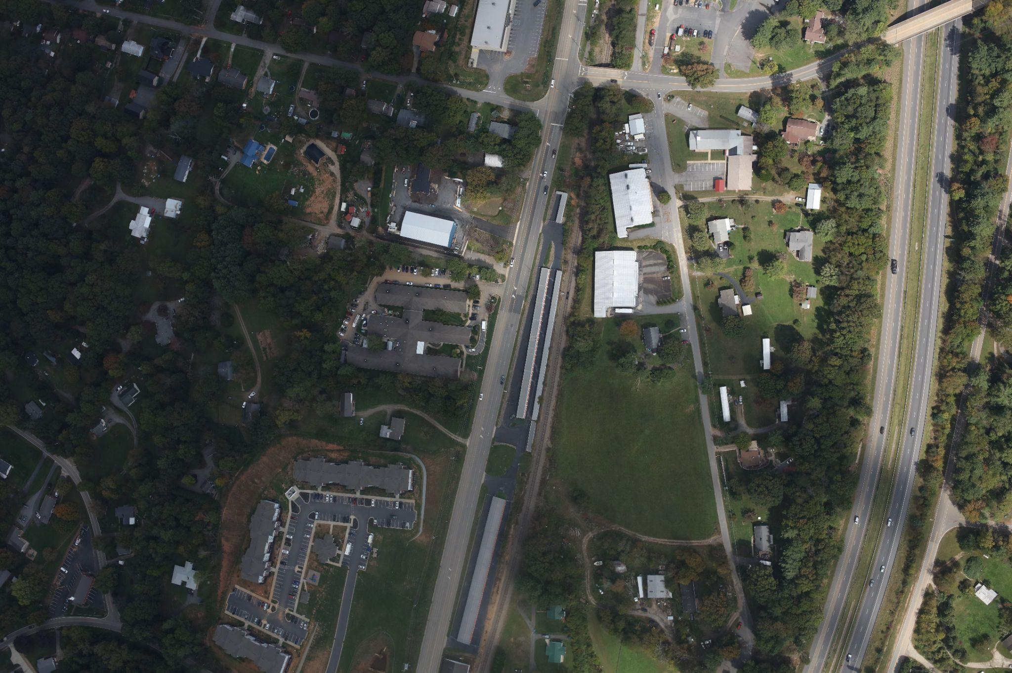
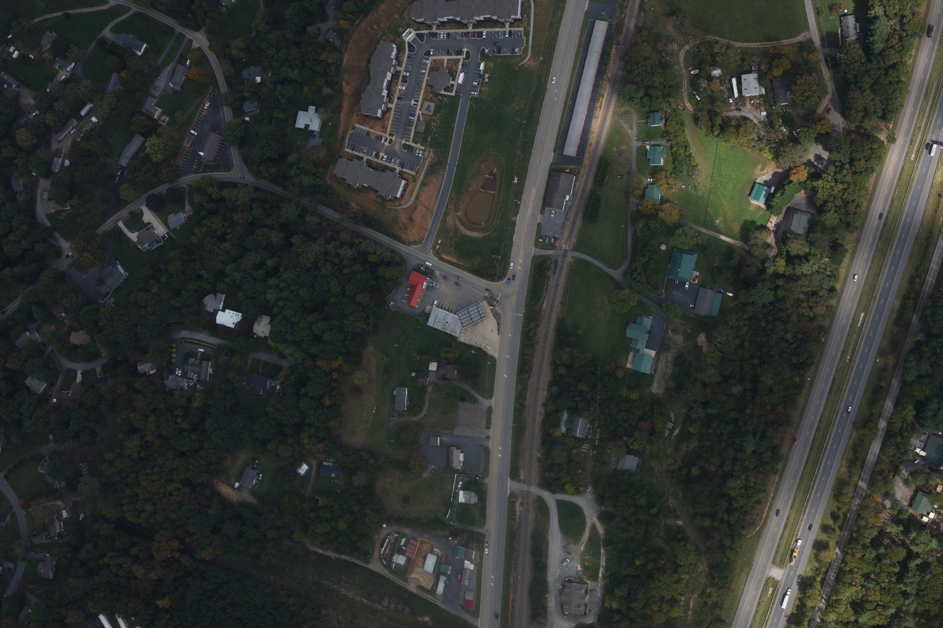
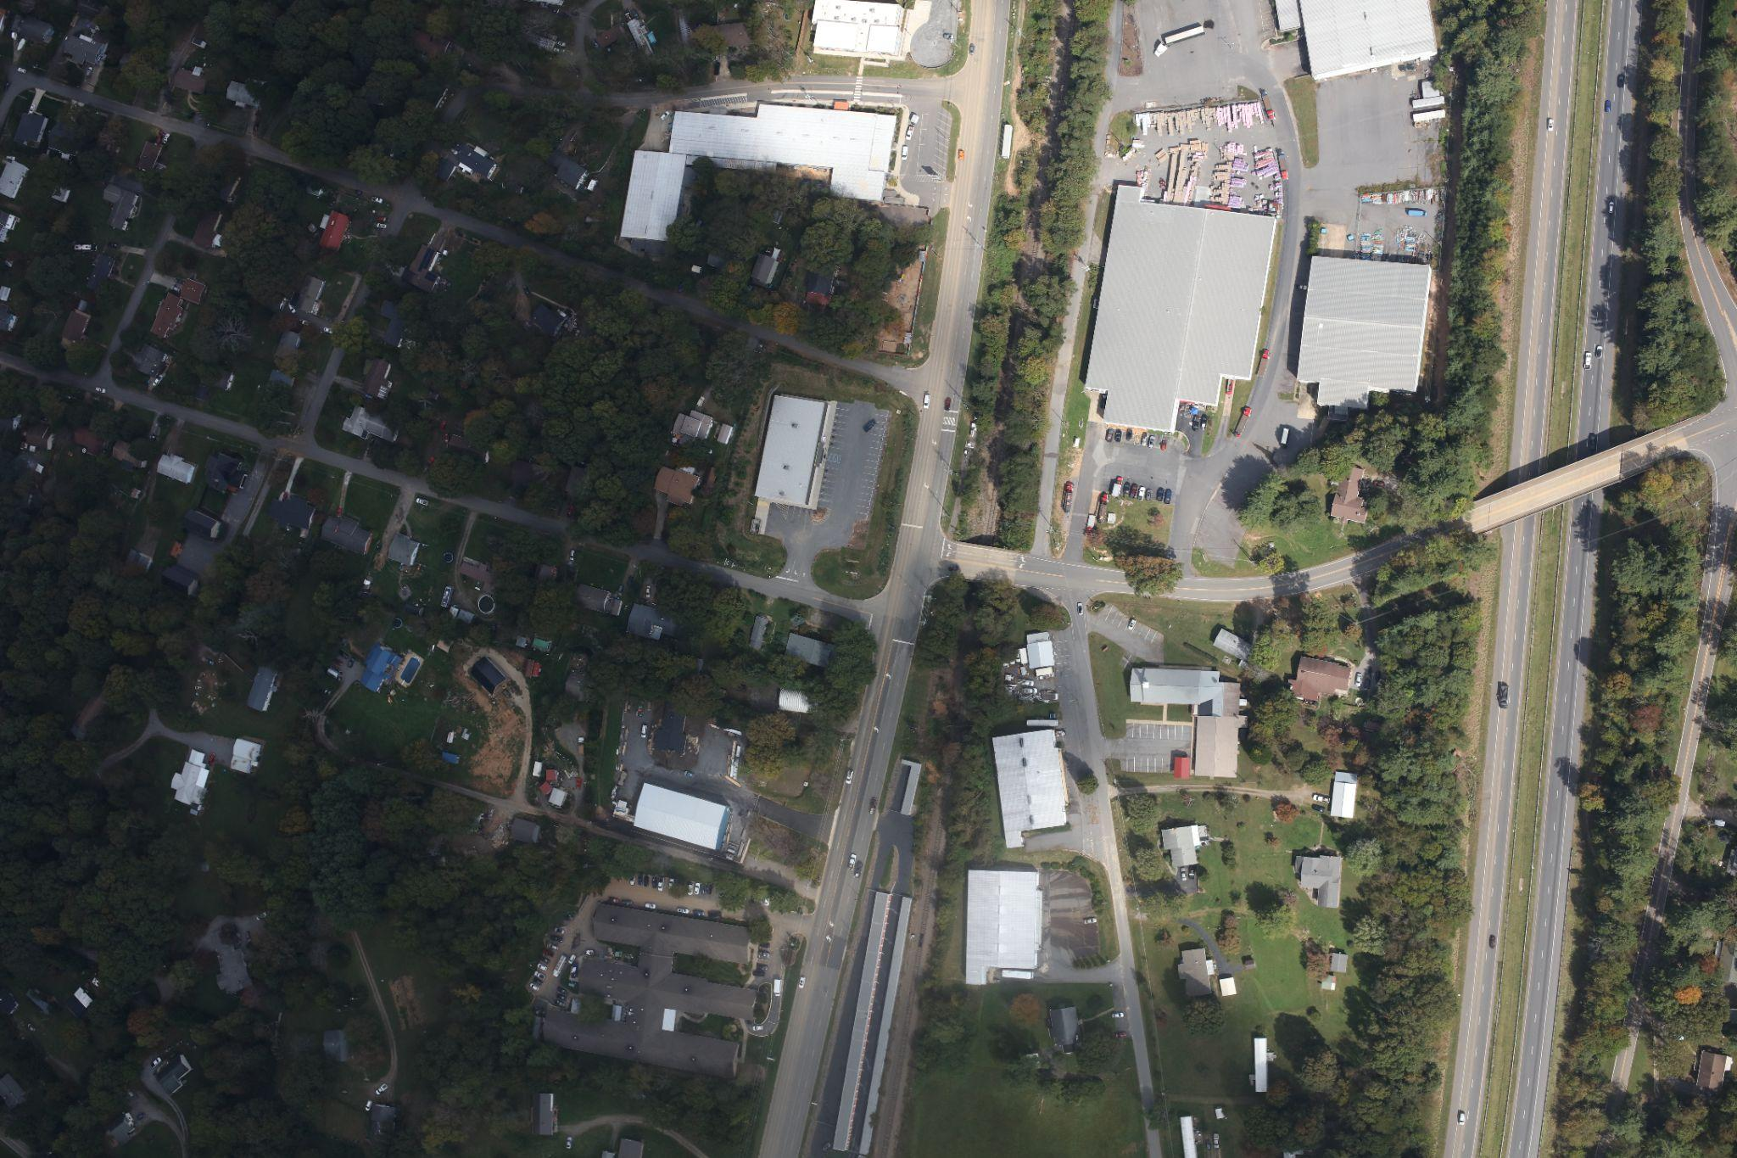
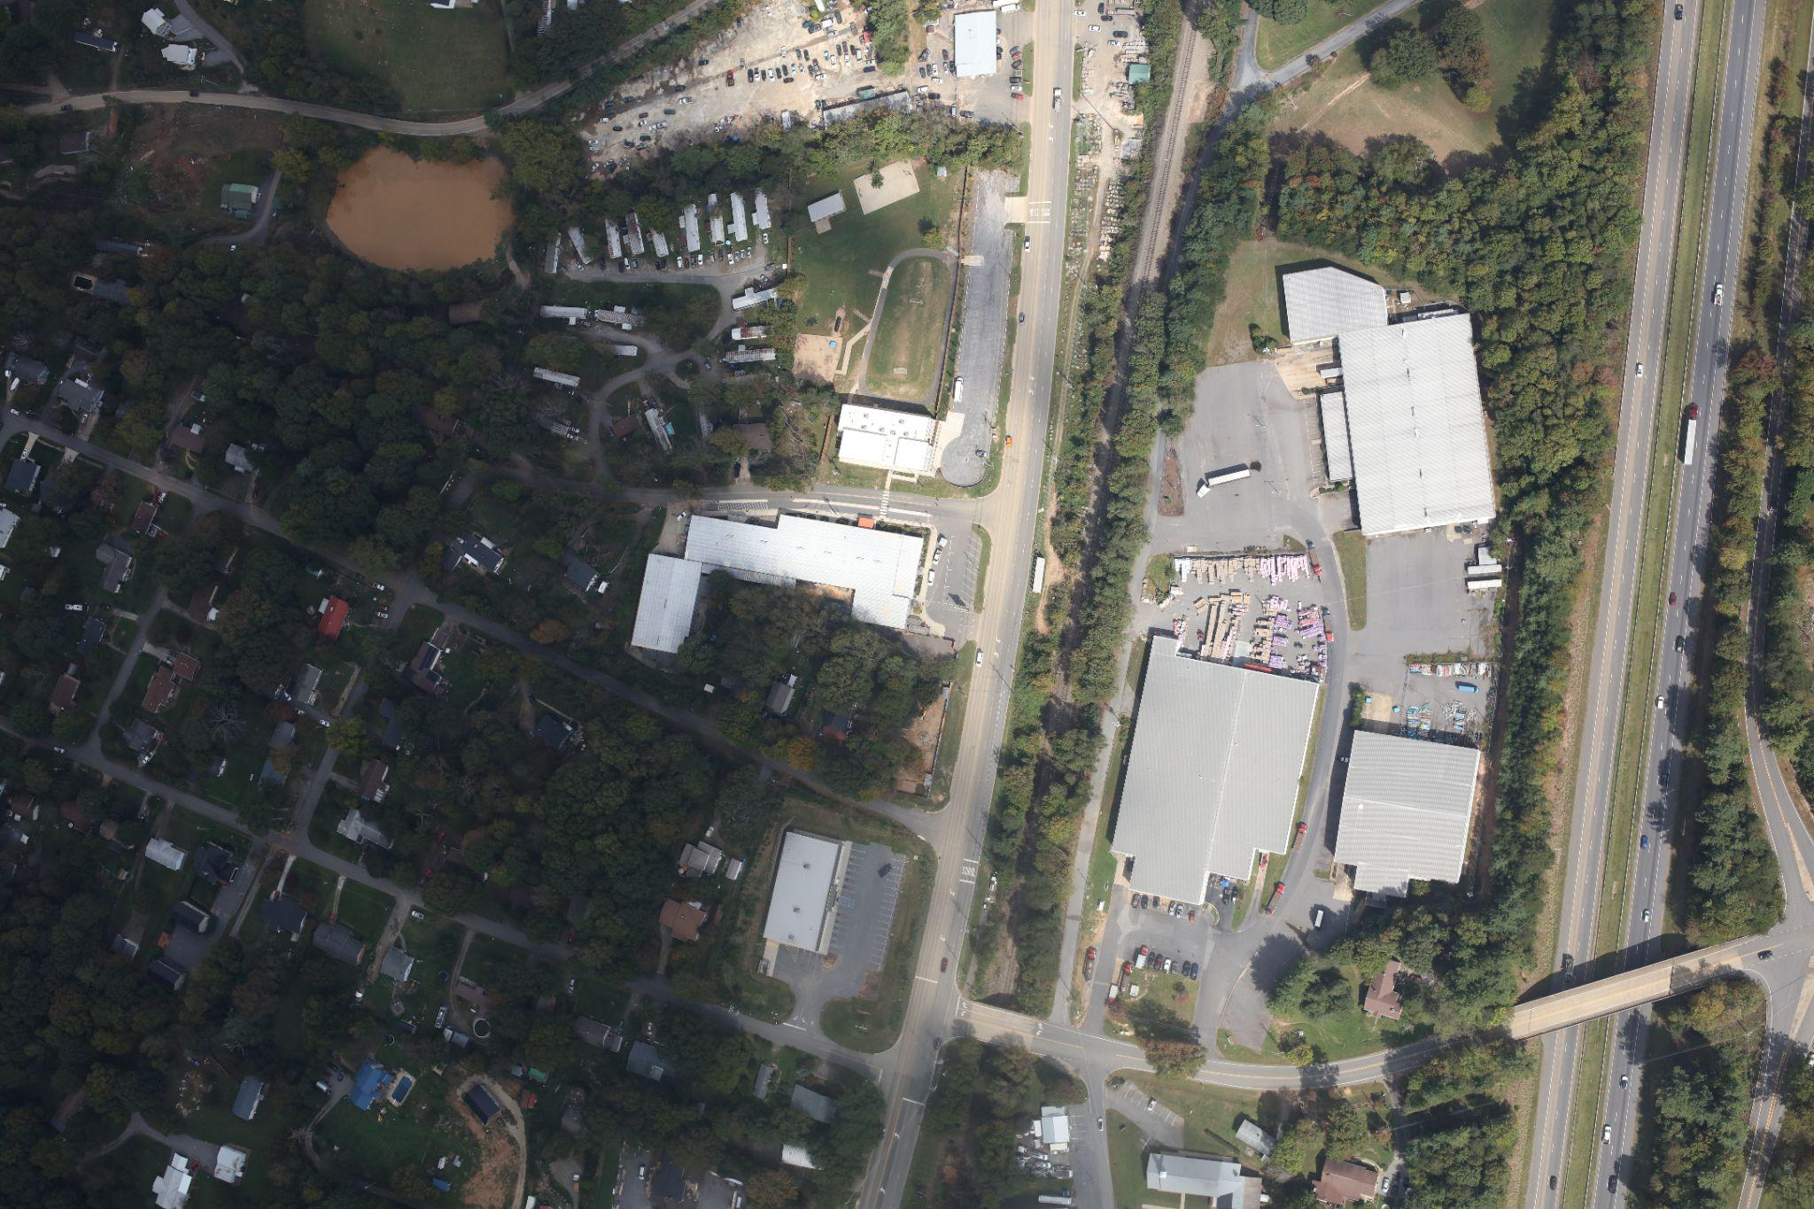
Challenges
What about LiDAR?
LiDAR is expensive and hard to coordinate and process rapidly
Photogrammetry and SfM
Lots of data to process quickly
No Ground Control Points
Large Forested Areas
Flights flown for imagery collection

Slide 7
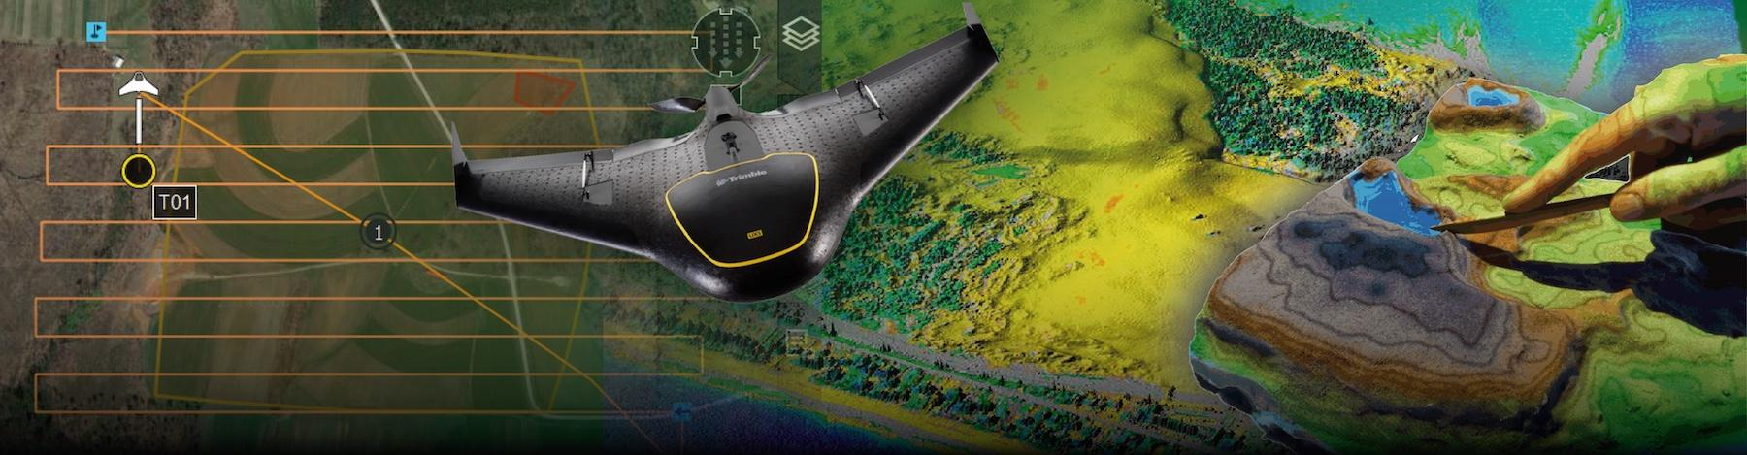
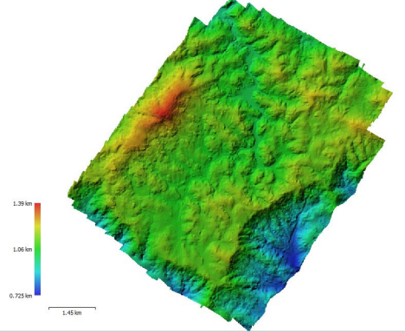
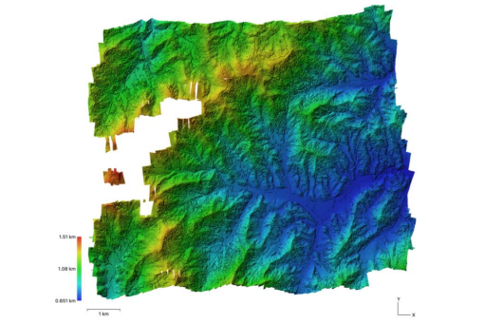
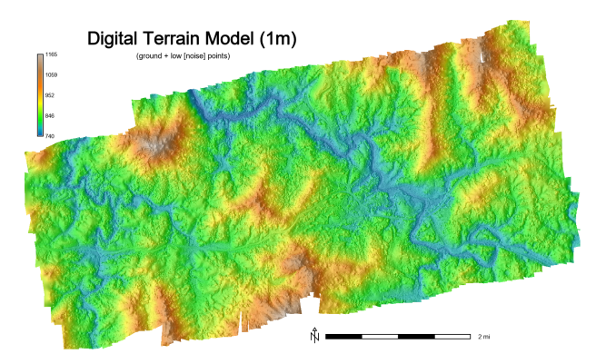
UAS Mapping and
Analysis
https://ncsu-geoforall-lab.github.io/gis-584-uas-course/
With Guidance from U.S. Army Corps of Engineers (Dr. Reckling)
8 student projects!!!
> 1000 Images
> 50 km²
Spruce Pine, NC
Blowing Rock, NC (Sorrento Skies/Ski Mountain/Downtown Area)
Roan Mountain, TN
US421N just East of Vilas, NC
Sandy Mush, NC
Hendersonville-E Flat Rock
Bearwallow-Chimney Rock
Student Created Digital Elevation Models (DEM)

Slide 8
Our Approach
Data Collection
Photogrammetry & SfM
Geoprocessing
Collect Raw Flight Image Data
CAP Civil Air Patrol
U.S. Air Force Auxiliary aids FEMA in disaster-response efforts.
ArcGIS REST API
ESRI ImageServer
Convert images into dense point cloud, orthomosaic, and mesh.
WebODM
AgiSoft Metashape
Post-processing with GRASS
Interpolate point cloud data into DSM.
Correct vertical shifts
Volumetric change estimations
Develop finalized data products

Slide 9
Data Collection
Civil Air Patrol Flights
Project: CAP-H-TS Helene 2024
Mission: 24-1-5849
35 Flights
Flown between
Sept 27 - Oct 8
Data
69,247 RGB JPEG Images (~1.41 TB)
Image Resolution: 8688 x 5792
Focal Length: 50mm
Pixel Size: 4.24 x 4.24 μm
Spatial
WGS84 (EPSG::4326)
Yaw, Pitch, Role
Flight Vector Data: https://services.arcgis.com/XG15cJAlne2vxtgt/ArcGIS/rest/services/Image_Points_view/FeatureServer/3/query
Notes:
post-storm aerial imagery collected by the Civil Air Patrol (CAP) provided crucial early data for understanding the full range of topographic disturbances. We employed structure-from-motion (SfM) to process 69,247 CAP aerial images (~1.41 TB) into digital surface models (DSM)

Slide 10
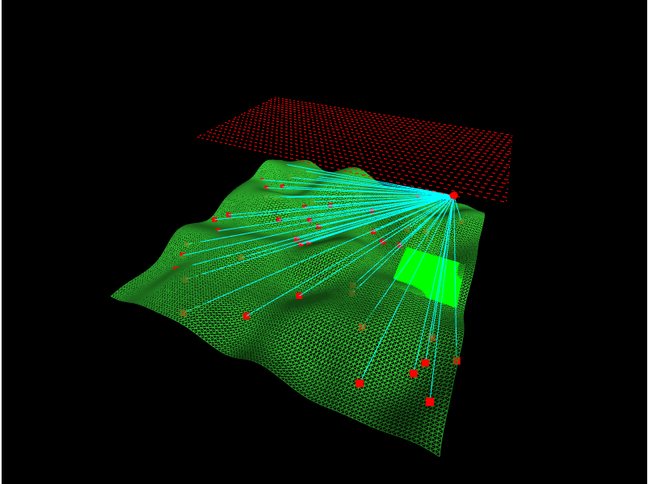
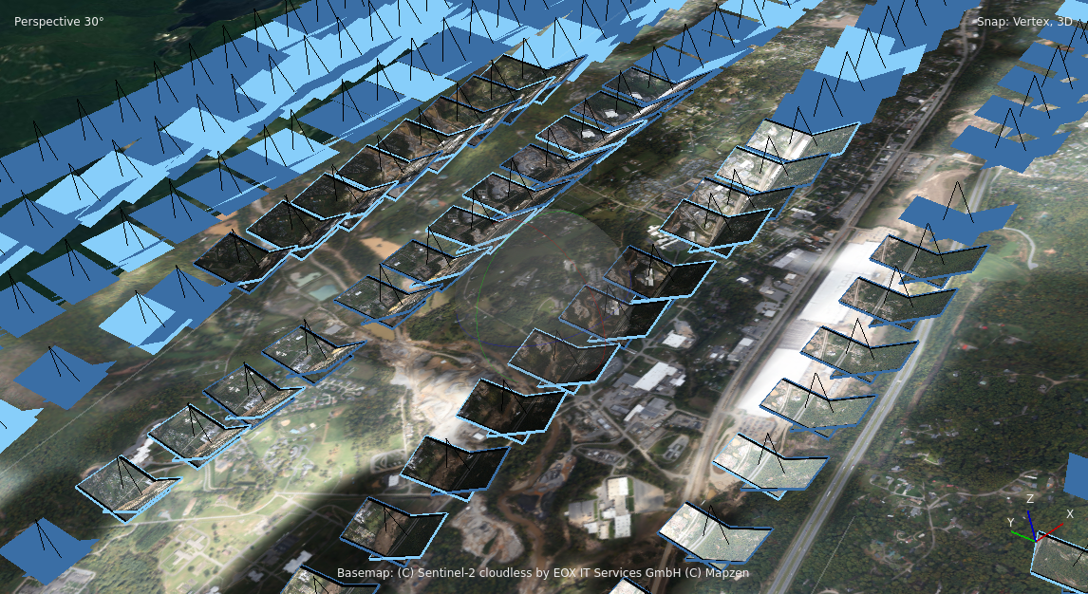
Photogrammetry & SfM (Structure from Motion)
Align Photos
Develop Depth Maps
Dense Point Clouds
Digital Elevation Model (DEM)
Mesh

Slide 11
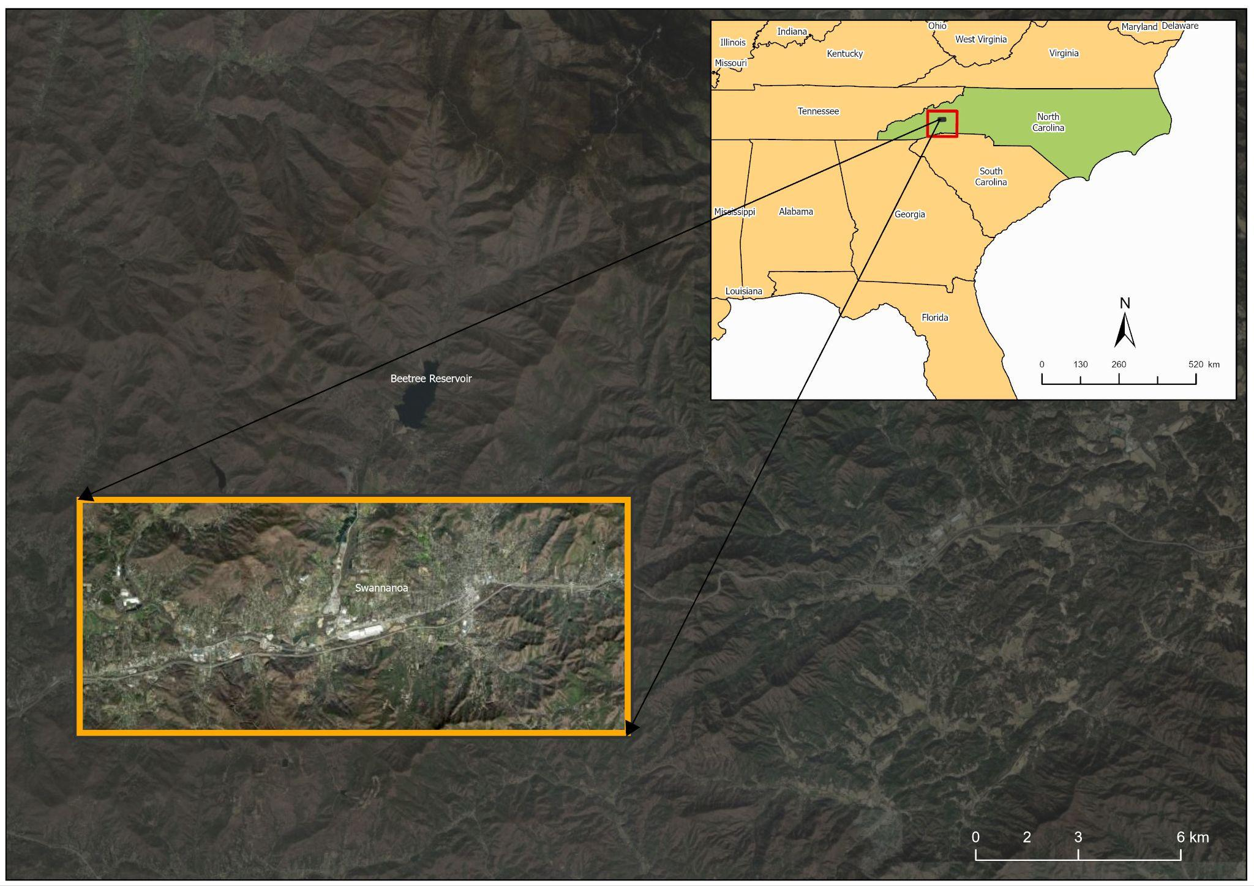
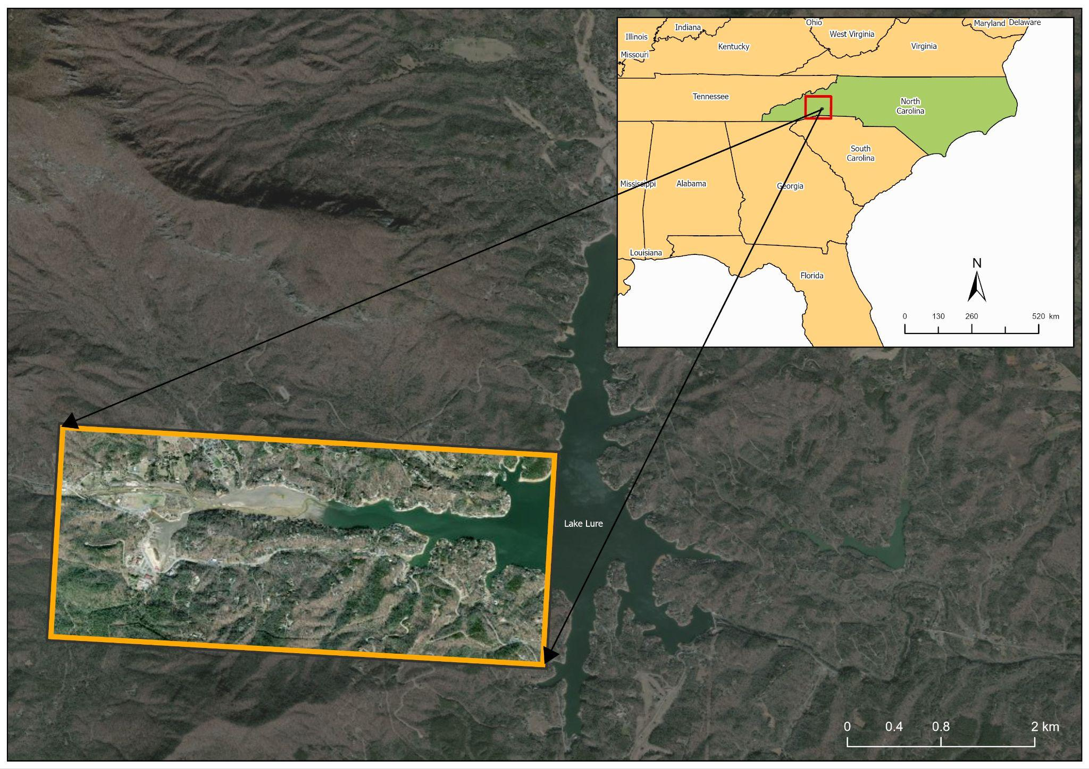
Communities
Swannanoa River
Valley
Bearwallow-Chimney Rock
Data Reprojected to NAD83(HARN) / North Carolina (EPSG:3358)

Slide 12
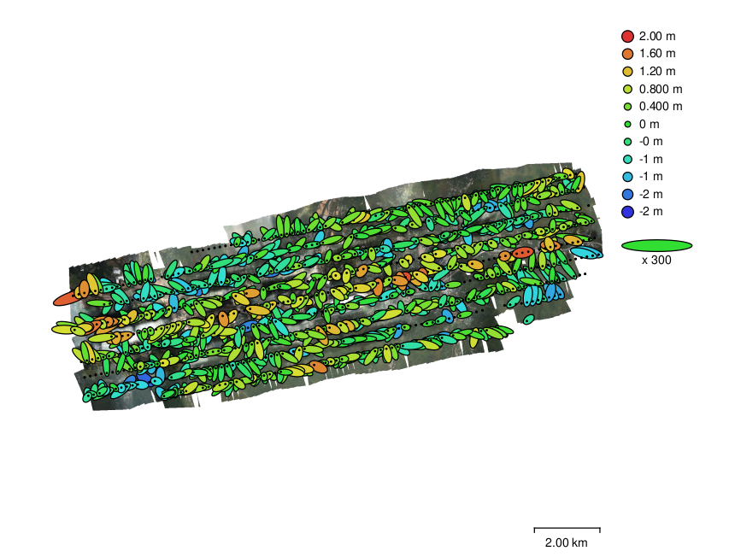
Swannanoa NC - CAP Flight A006B
Number of images:1,515
Camera stations: 1,504
Flying altitude: 960 m
Tie points: 2,064,970
Ground resolution: 7.98 cm/pix
Projections: 5,164,112
Coverage area: 80.6 km²
Reprojection error: 2.08 pix
Camera Locations and Error Estimates

Slide 13
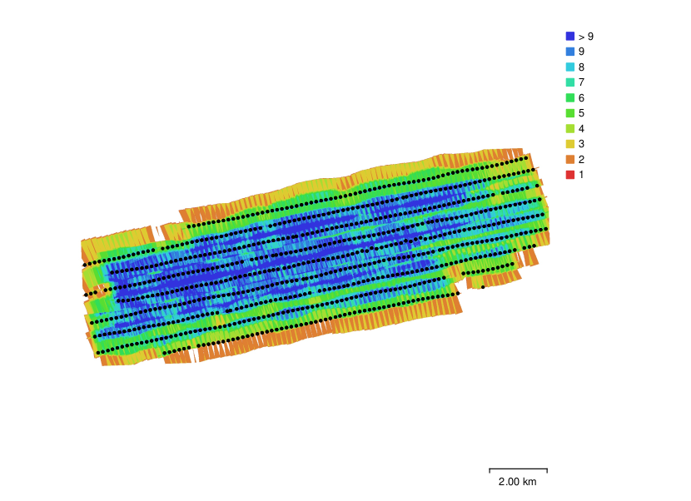
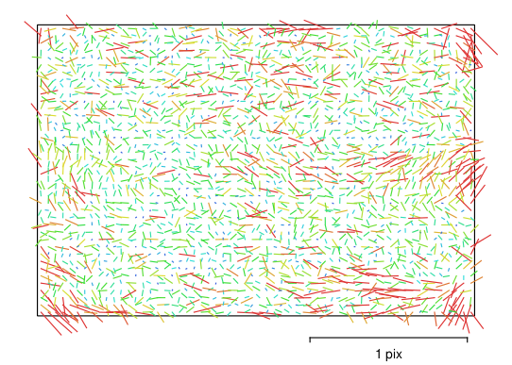
Camera Calibration
Camera Locations and Image Overlap
Image residuals for Canon EOS 5DS R, EF50mm f/1.4 USM (50mm).

Slide 14
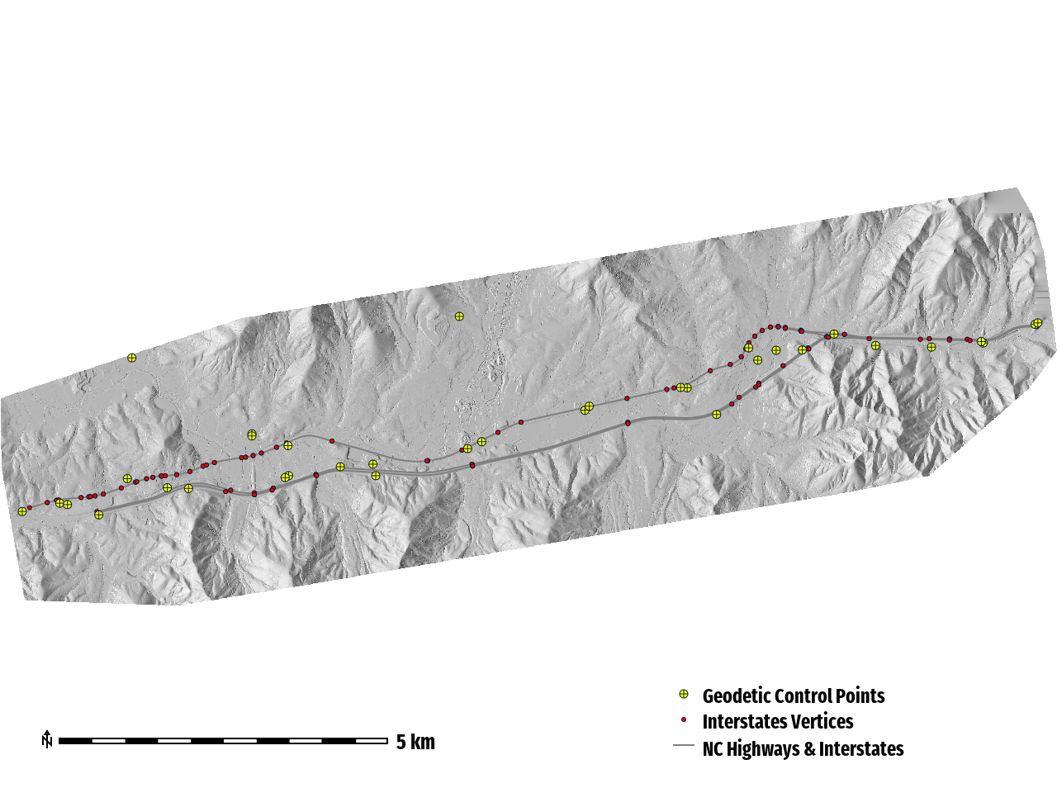
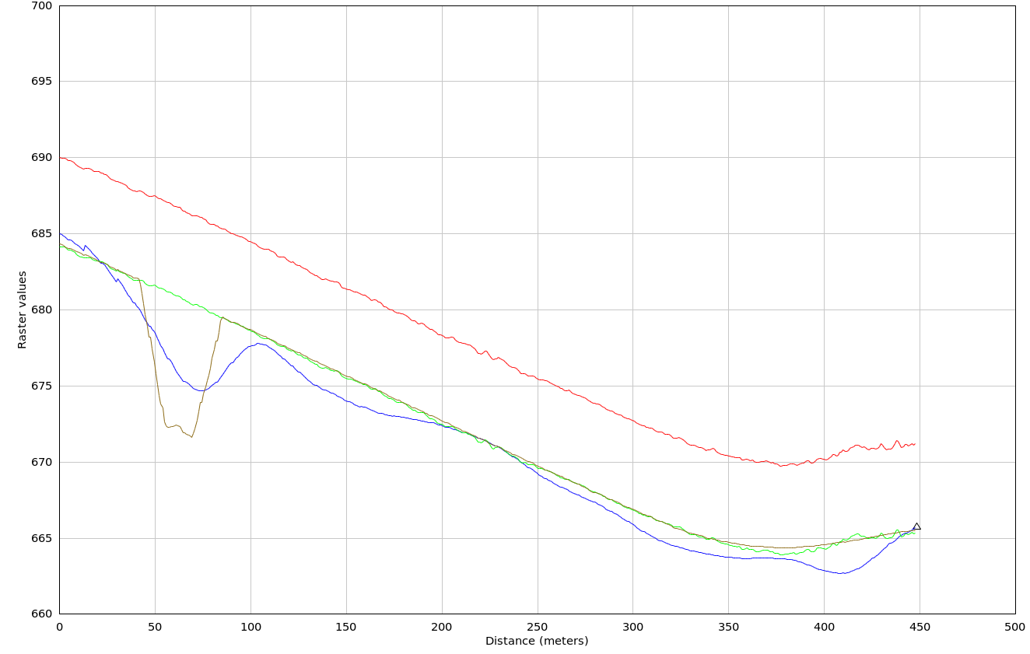
Systematic Vertical Shift
Pre-Correction Vertical Error
MSE: 56.89 m
RMSE: 7.54 m
RMdSE (Median): 5.25 m
Post-Vertical Alignment
RMSE: 0.39 m (~1.28 US Survey feet)
LiDAR to Geodetic Control Point v. DTM
RMSE: 0.121 m

Slide 15
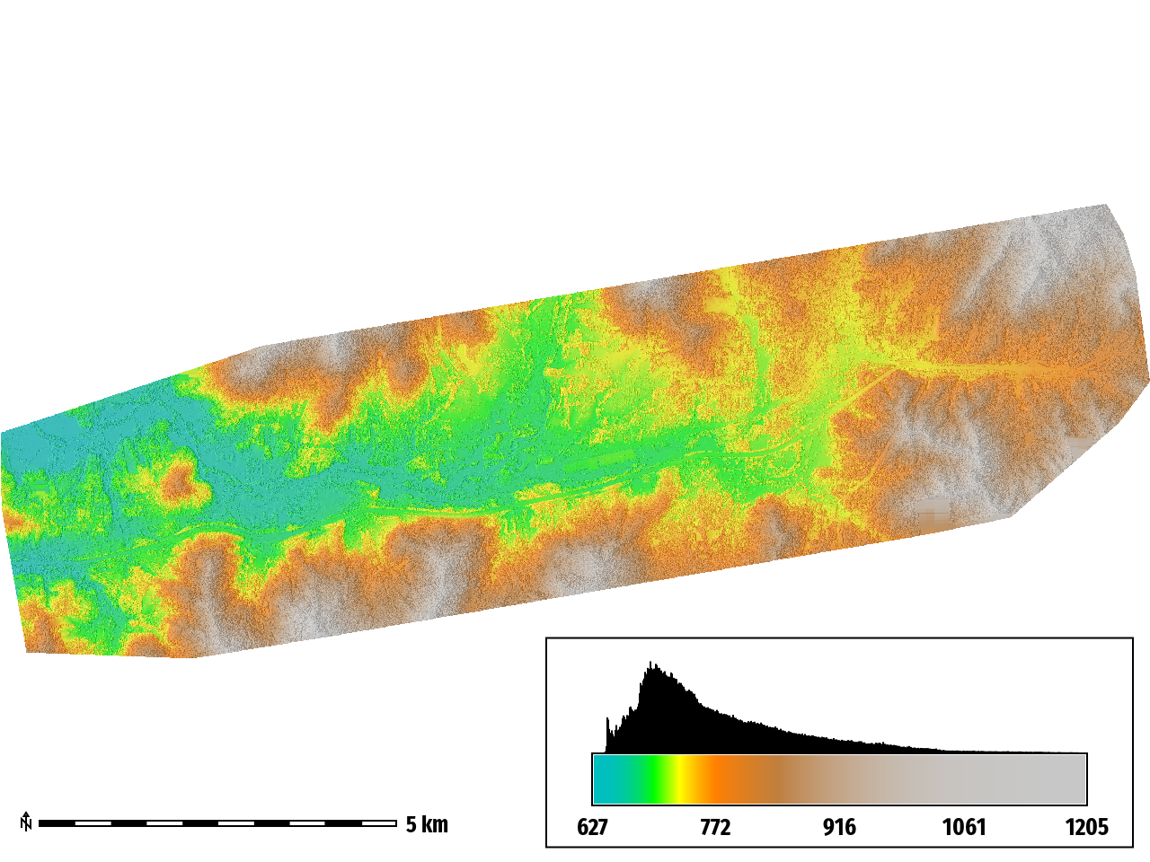
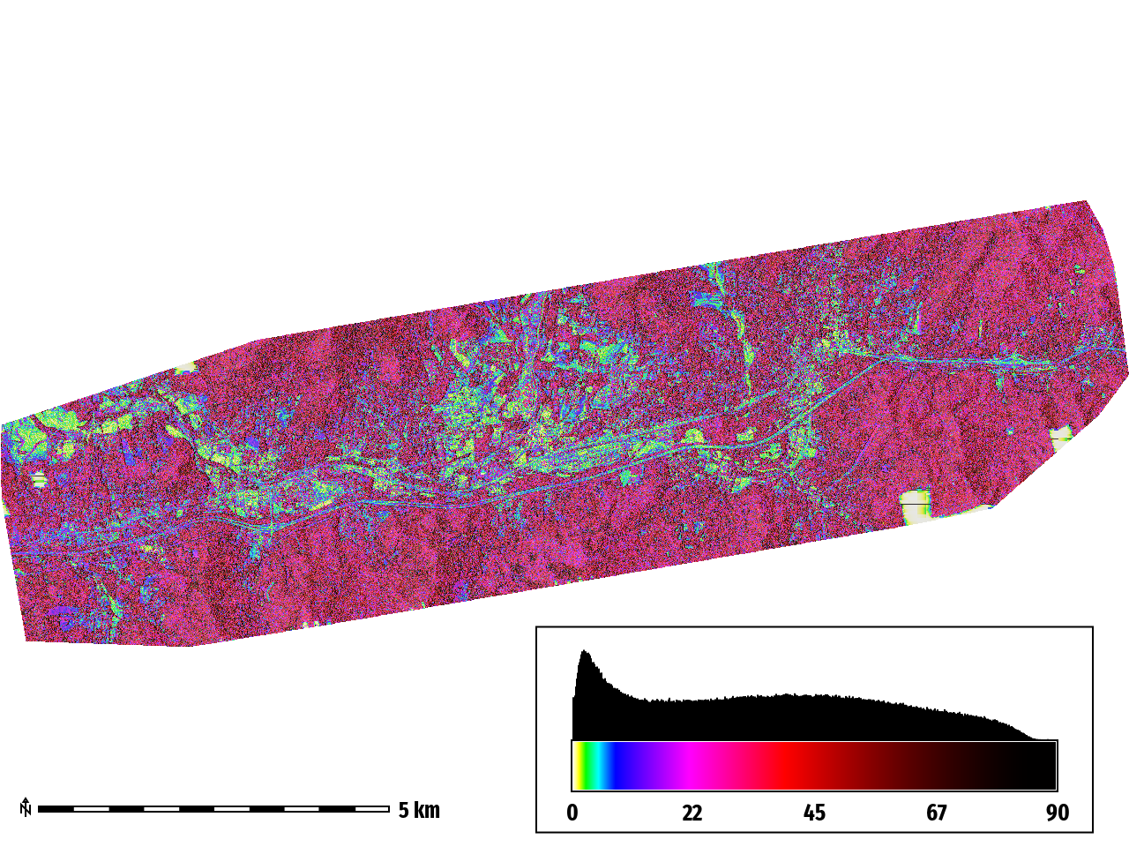
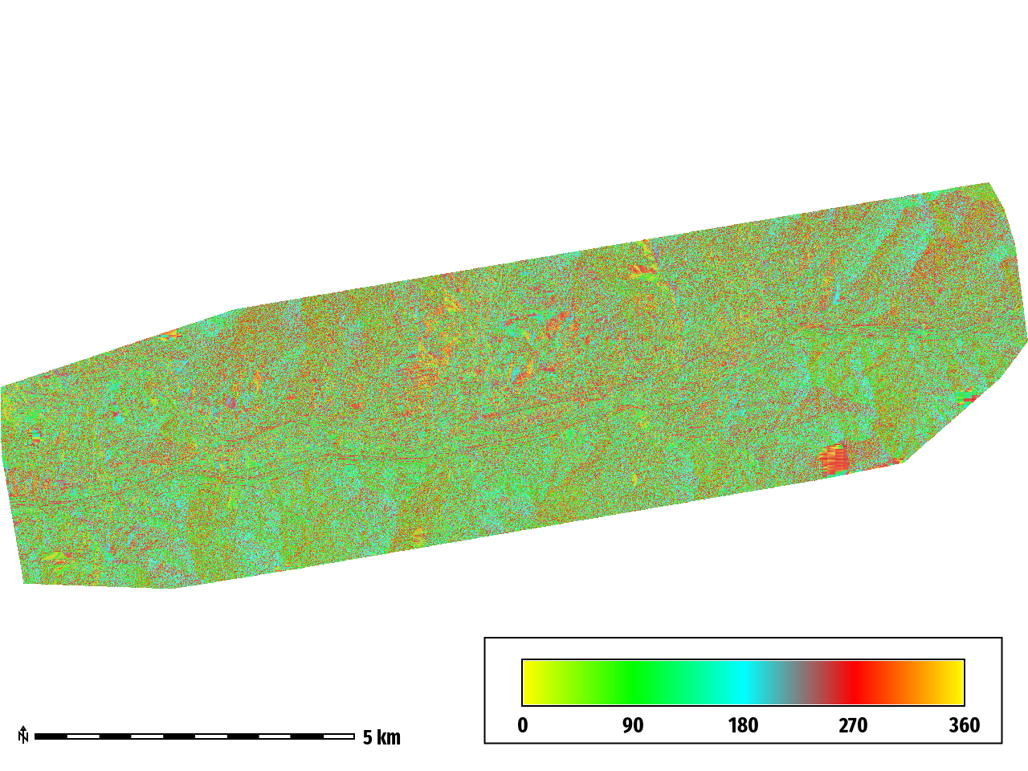
Topographic Derivatives
DSM (Digital Surface Model)
Slope
Aspect
minimum: 627.142
maximum: 1205.31
range: 578.165
mean: 774.047
mean of absolute values: 774.047
standard deviation: 92.2234
median : 746.752
minimum: 0.000618198
maximum: 88.5532
range: 88.5526
mean: 35.3713
mean of absolute values: 35.3713
standard deviation: 23.0795
median: 34.8844
minimum: 2.20804e-05
maximum: 360
range: 360
mean: 180.977
mean of absolute values: 180.977
standard deviation: 102.844
median: 181.068

Slide 16
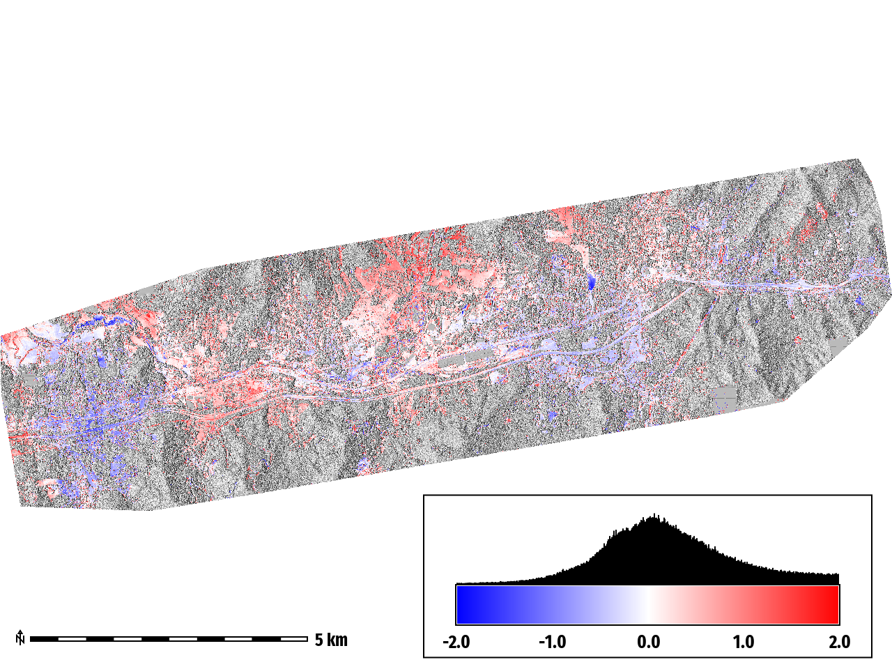
Topographic Change
minimum: -2
maximum: 2
range: 4
mean: 0.21599
mean of absolute values: 0.5558
standard deviation: 0.694954
median: 0.150562

Slide 17
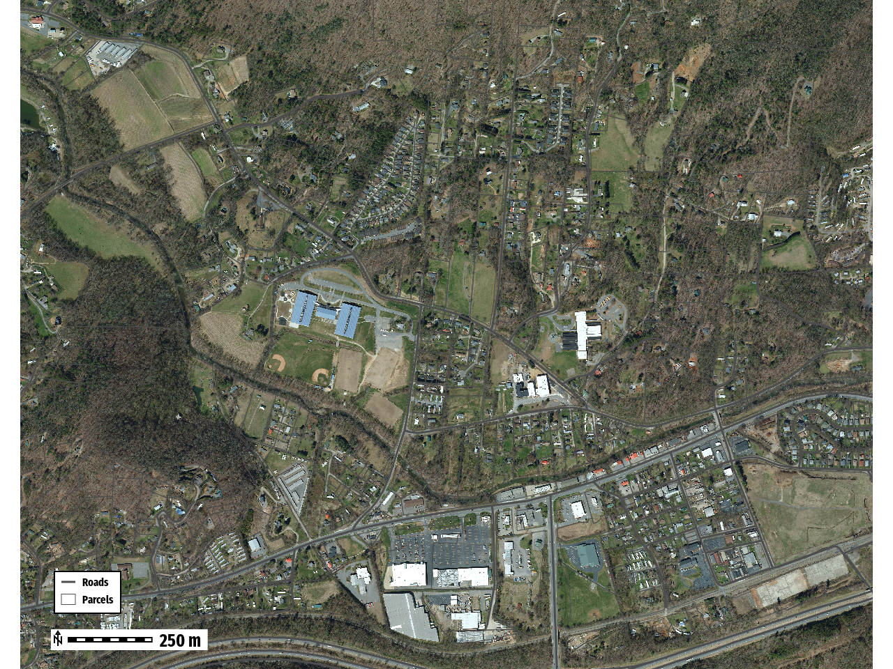
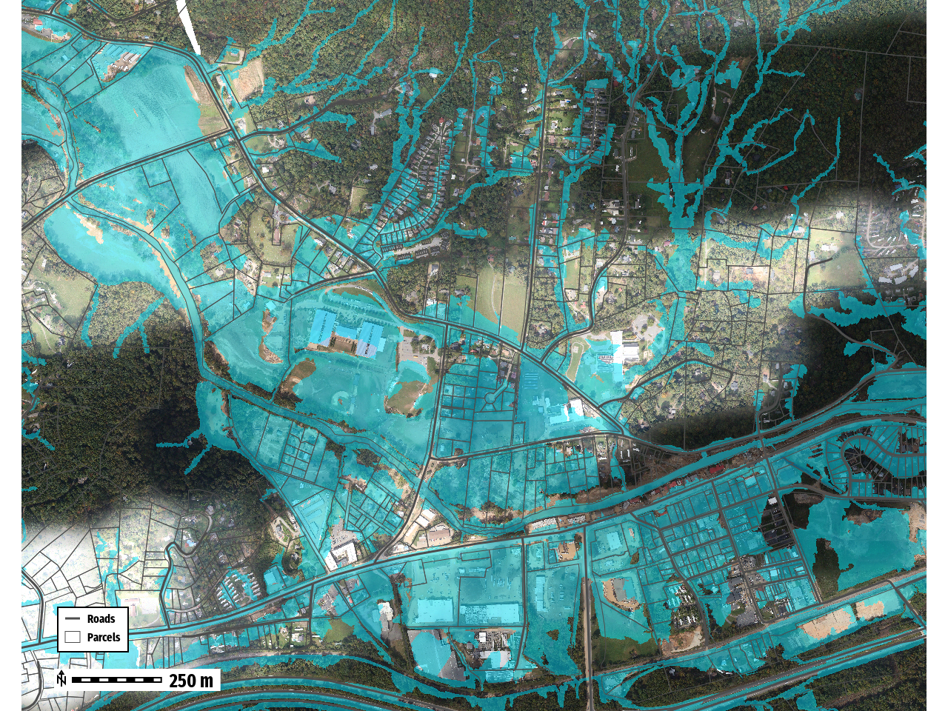
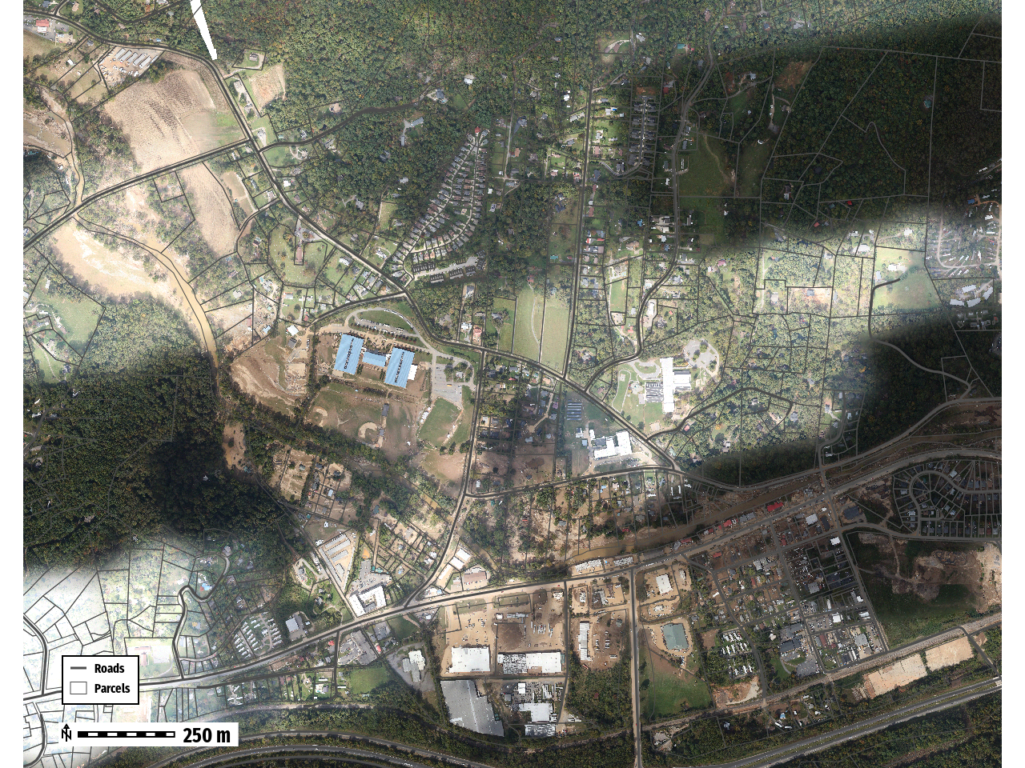
Swannanoa, NC
Record Gauge Height
27.33 ft
2019
October 6th, 2024
Town
NC-70
AOI
I-40

Slide 18
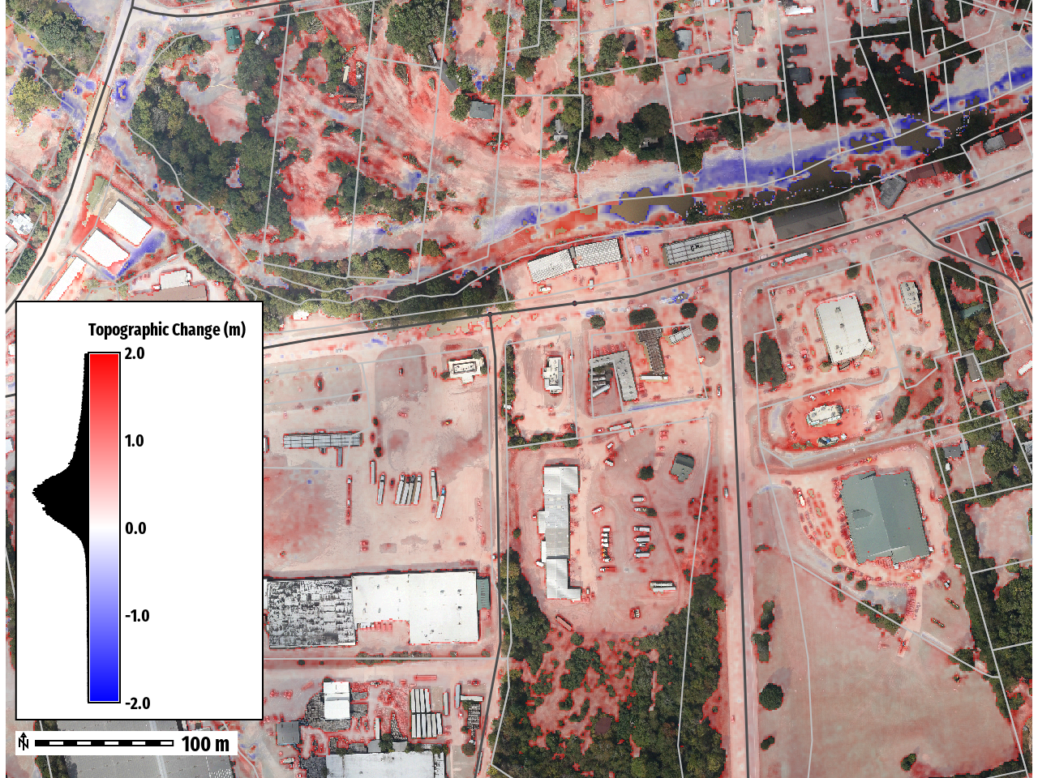
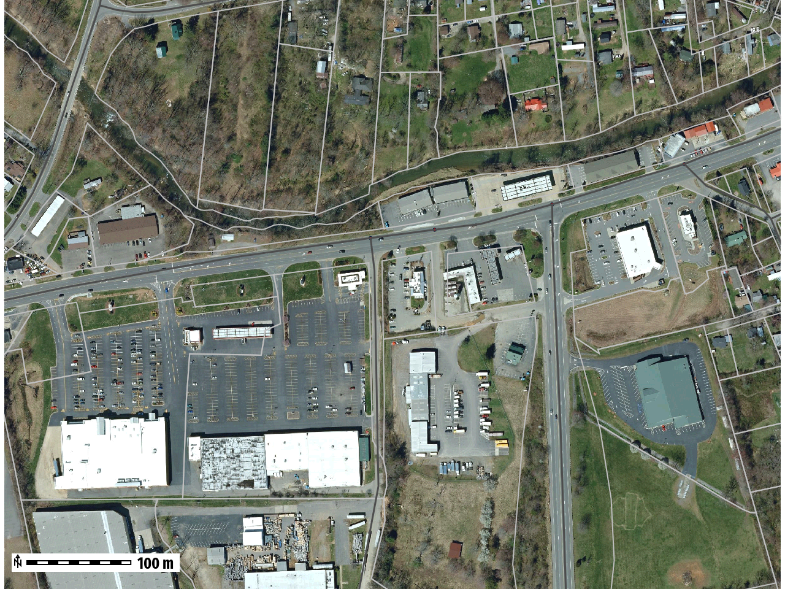
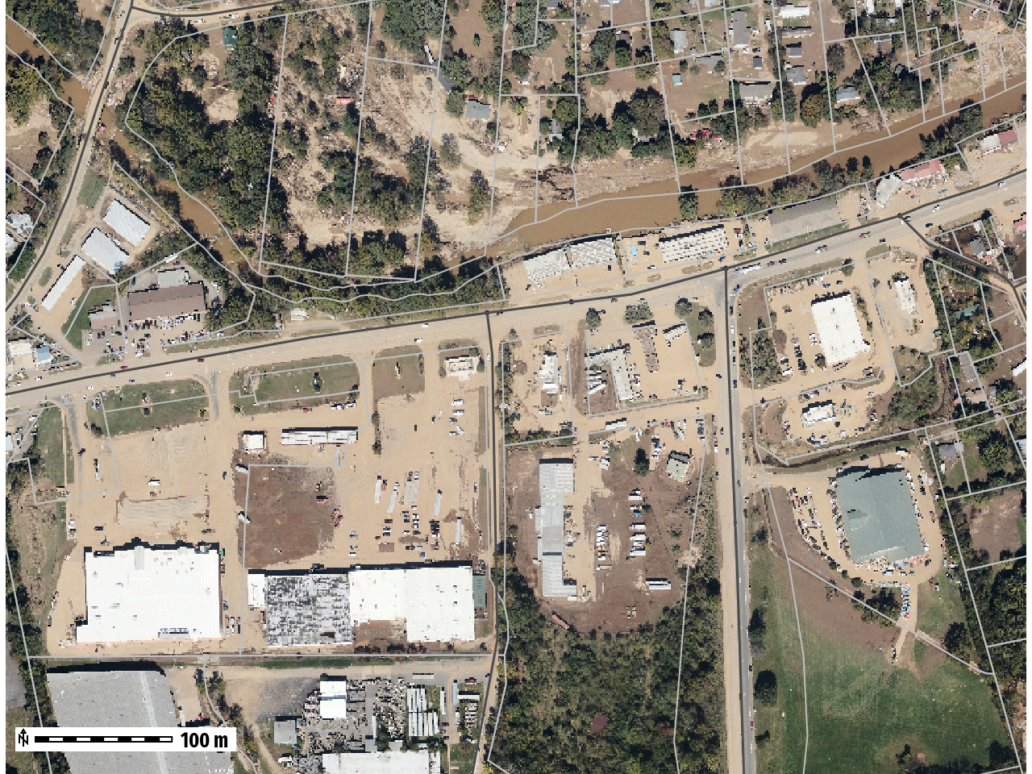
2019
October 6th, 2024

Slide 19
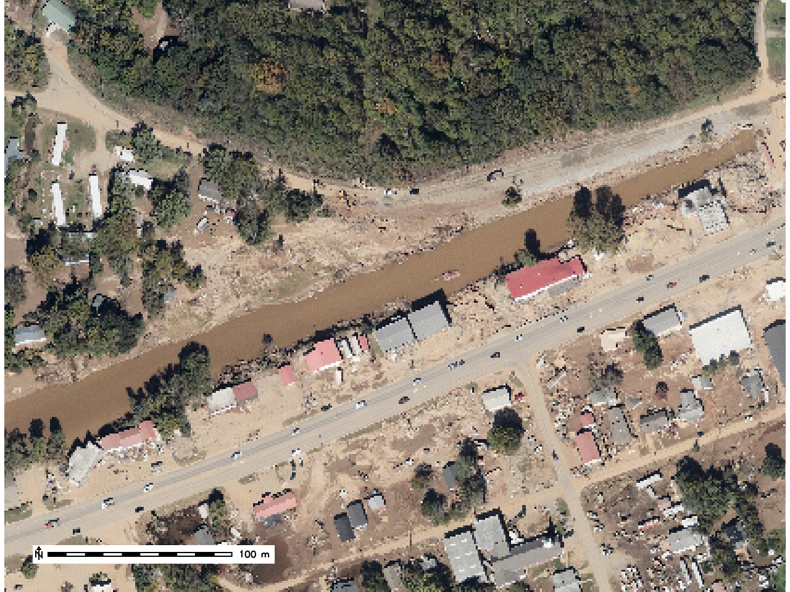
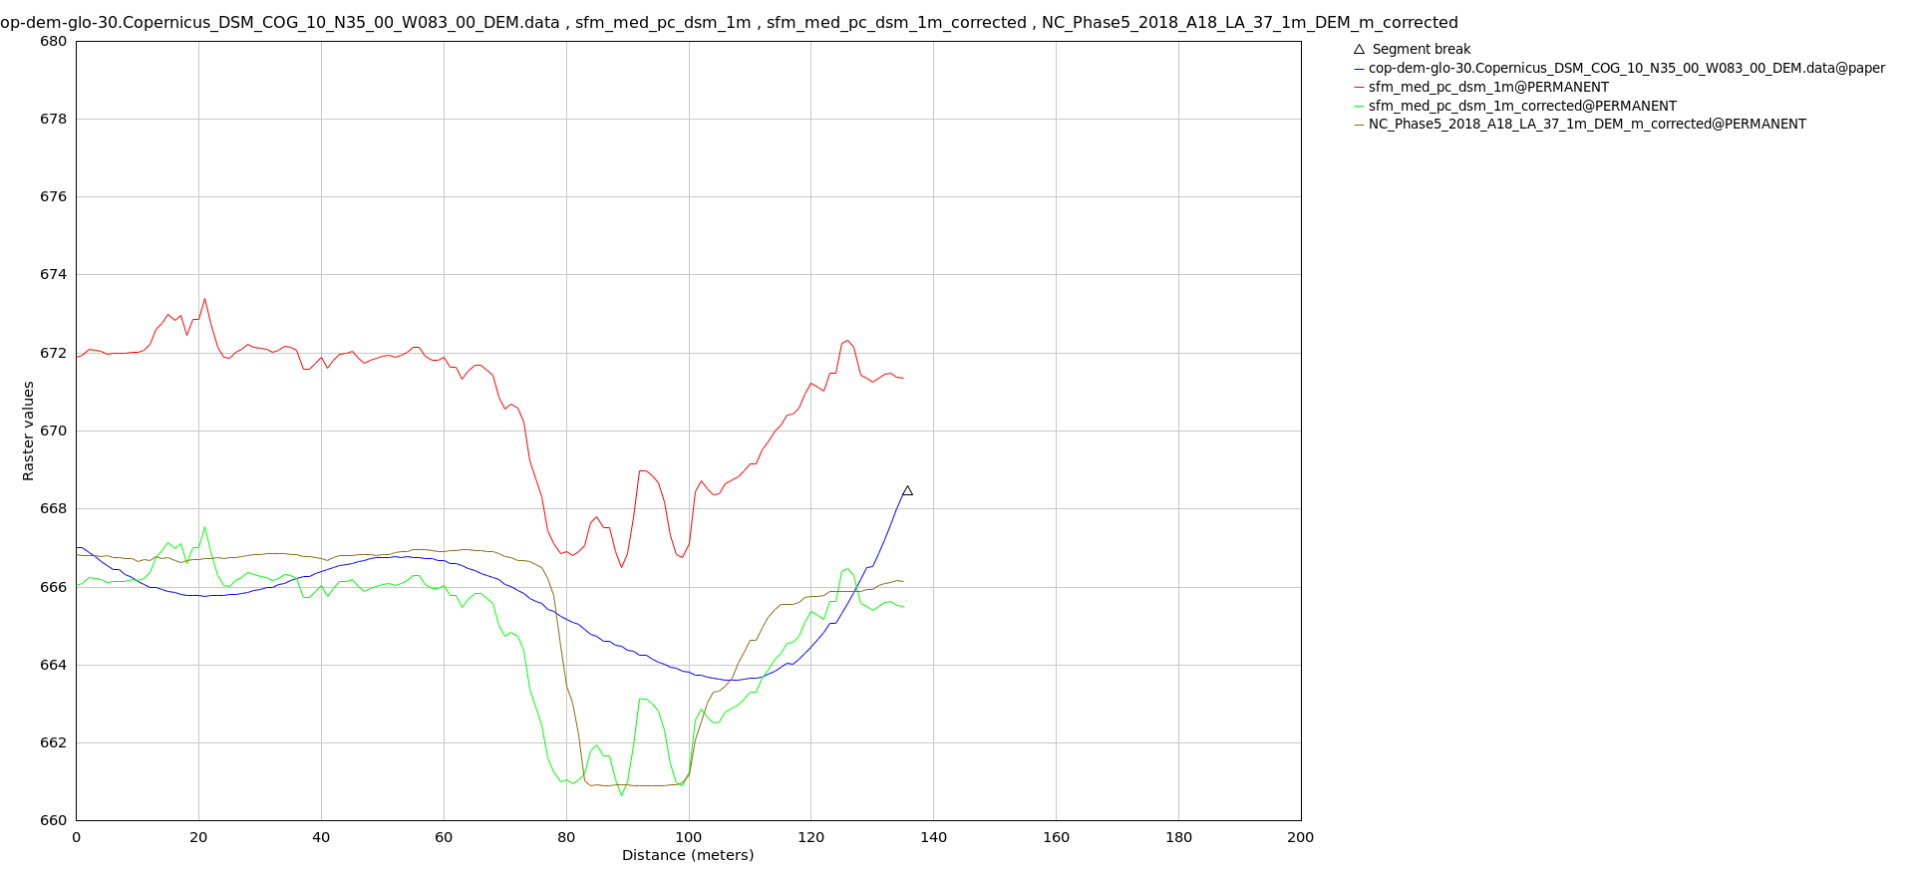
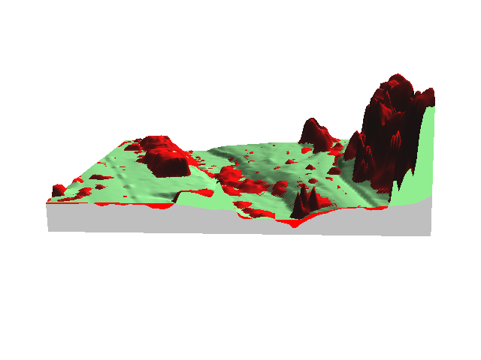
Stream Bank Erosion
SfM DSM - Not Corrected
B
COP-DEM-GLO-30
NC Phase 2018 LiDAR DTM
A
Corrected SfM DSM
A
B
Erosion

Slide 20
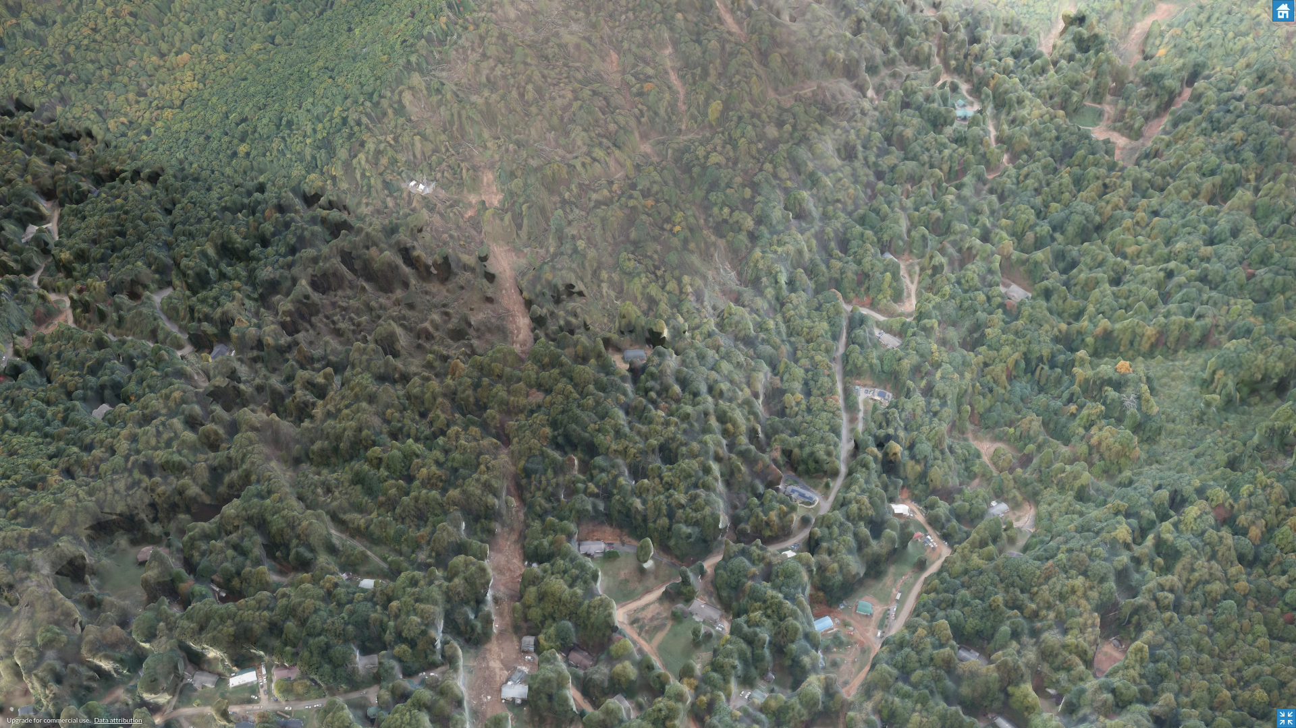
Landslides
Top of Landslide
Hidden by Canopy
Bottom of Landslide

Slide 21
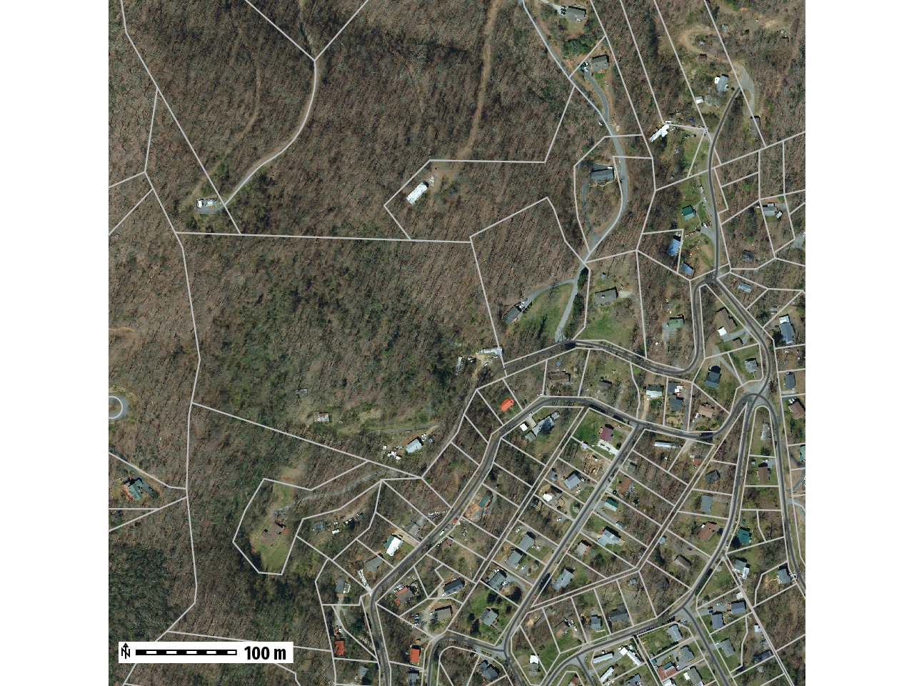
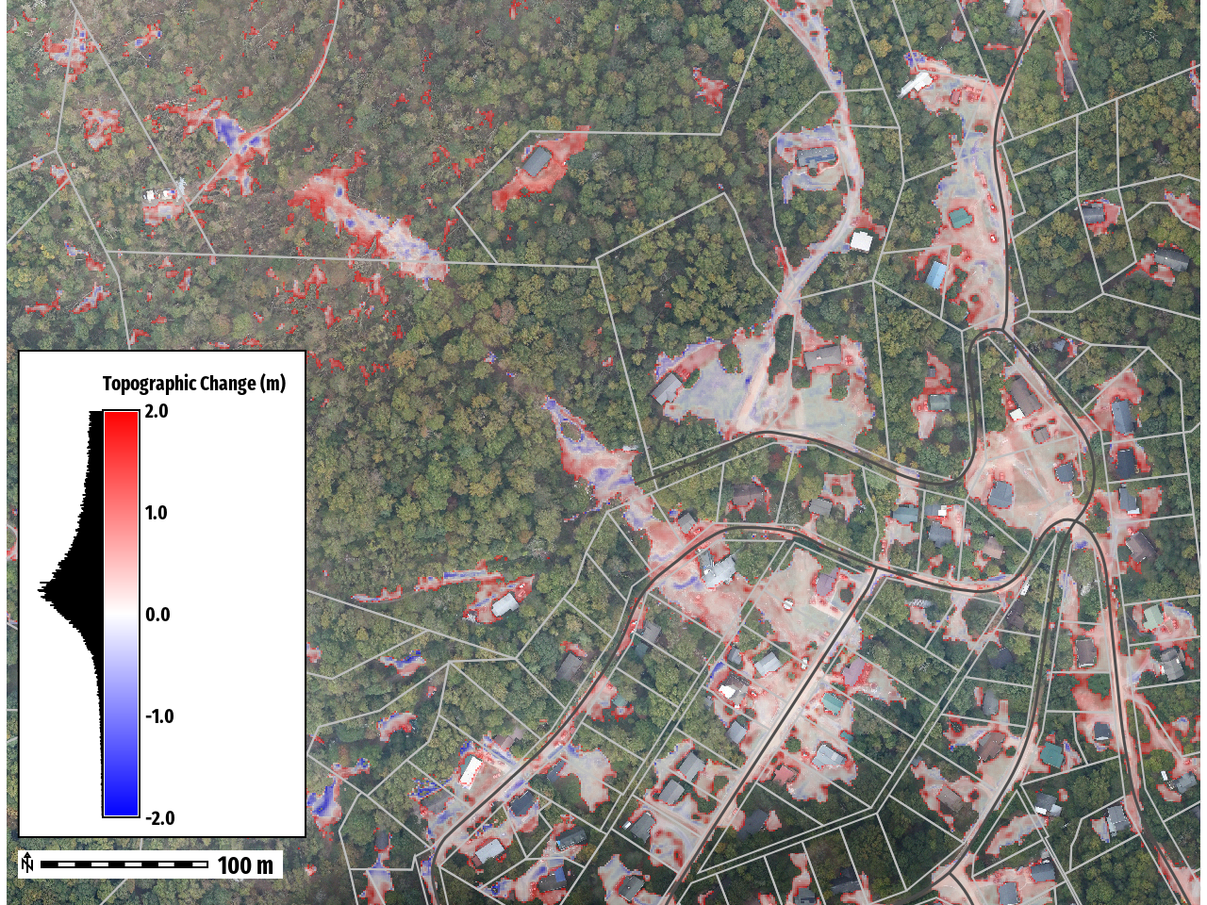
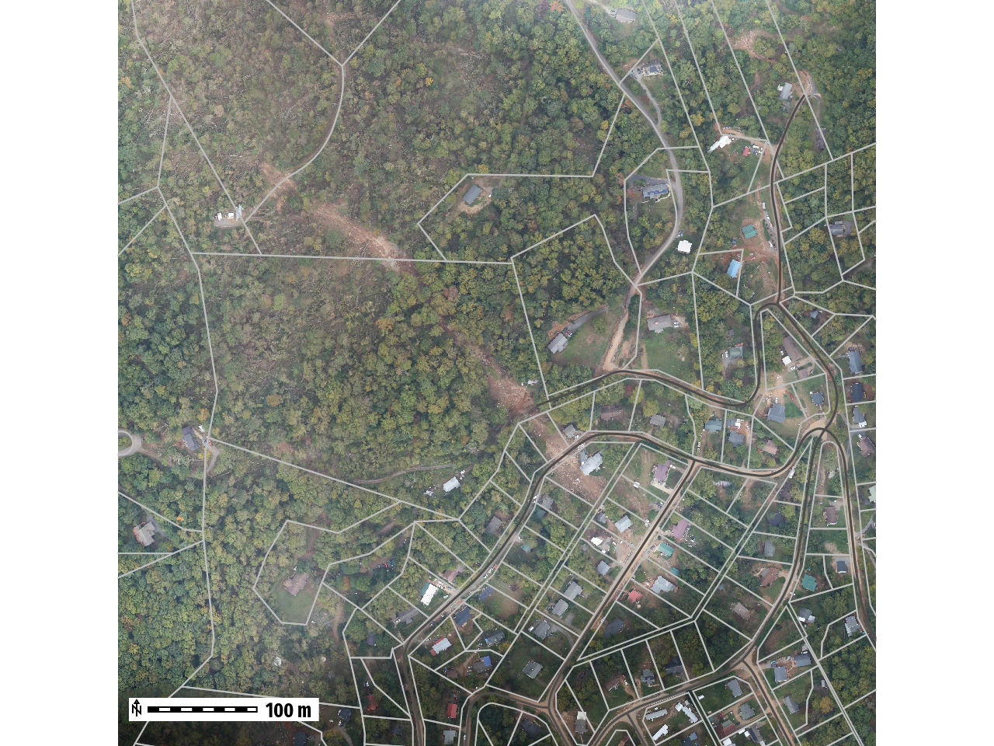
Landslides
2019
2024

Slide 22
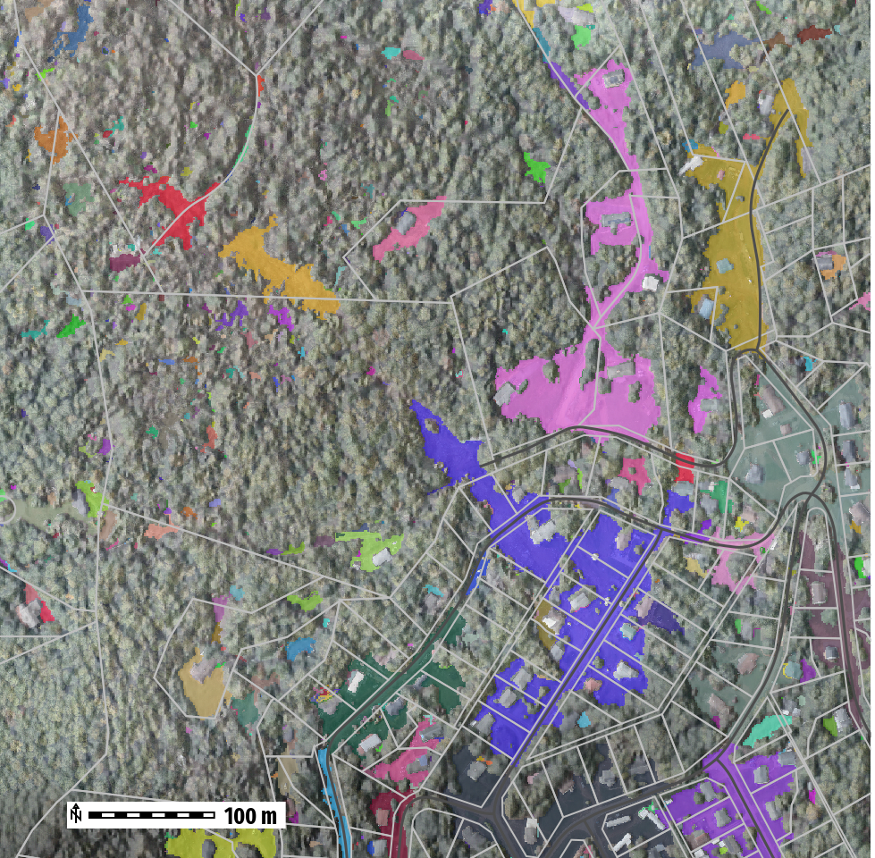

Landslides
Number of Clumps: 3
Clump | Volume (m³) | Average (Difference) | Area (m²)
1 | 694.01 | 0.51 | 1355
2 | 1422.83 | 0.59 | 2409
3 | 5757.43 | 0.40 | 14771
Total | 7874.27 |  | 18535
1
2
3
Estimate Debris Removal Cost
~788 Loads (10m³ per load)
$78K - $158k Removal Cost
https://www.fema.gov/appeal/debris-removal-1

Slide 23
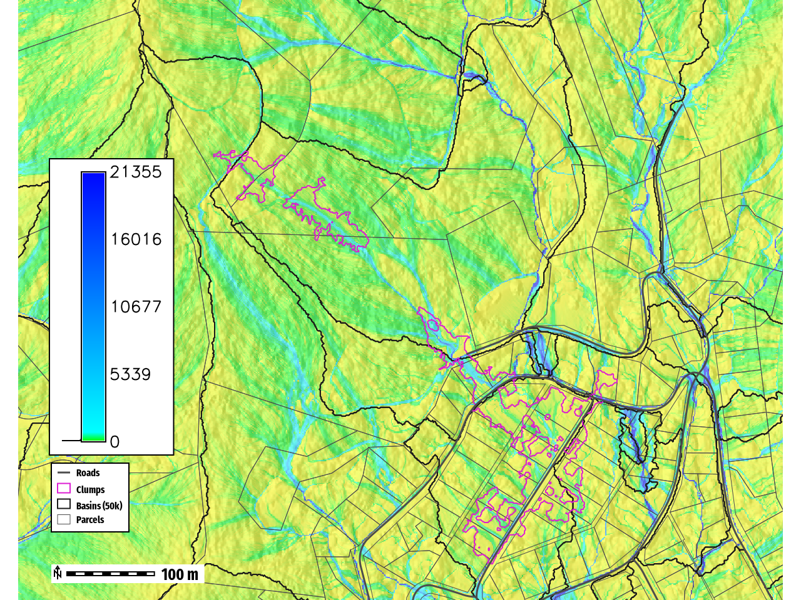
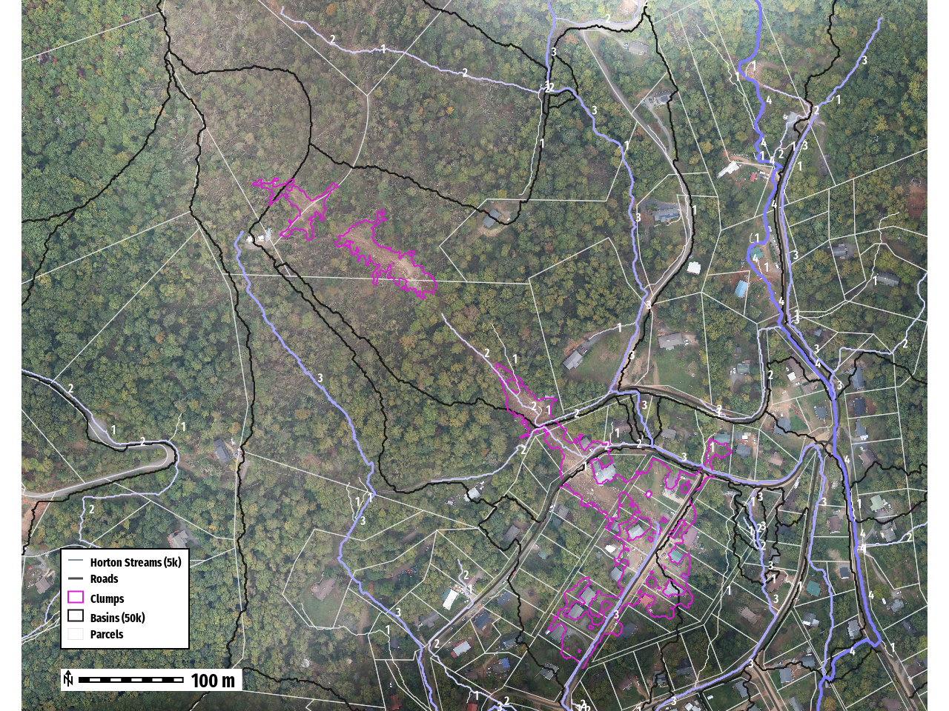
Flow Accumulation & Streams
Notes:
Computes sediment transport capacity - (Erosion Modeling in GIS book chapter)
Water depth * slope (power function)

Slide 24
Bearwallow-Chimney Rock - CAP Flight A006B
Number of images:1,444
Camera stations: 1,254
Flying altitude: 1.04 km
Tie points: 1,893,146
Ground resolution: 9.28 cm/pix
Projections: 4,512,928
Coverage area: 75.2 km²
Reprojection error: 1.18 pix

Slide 25
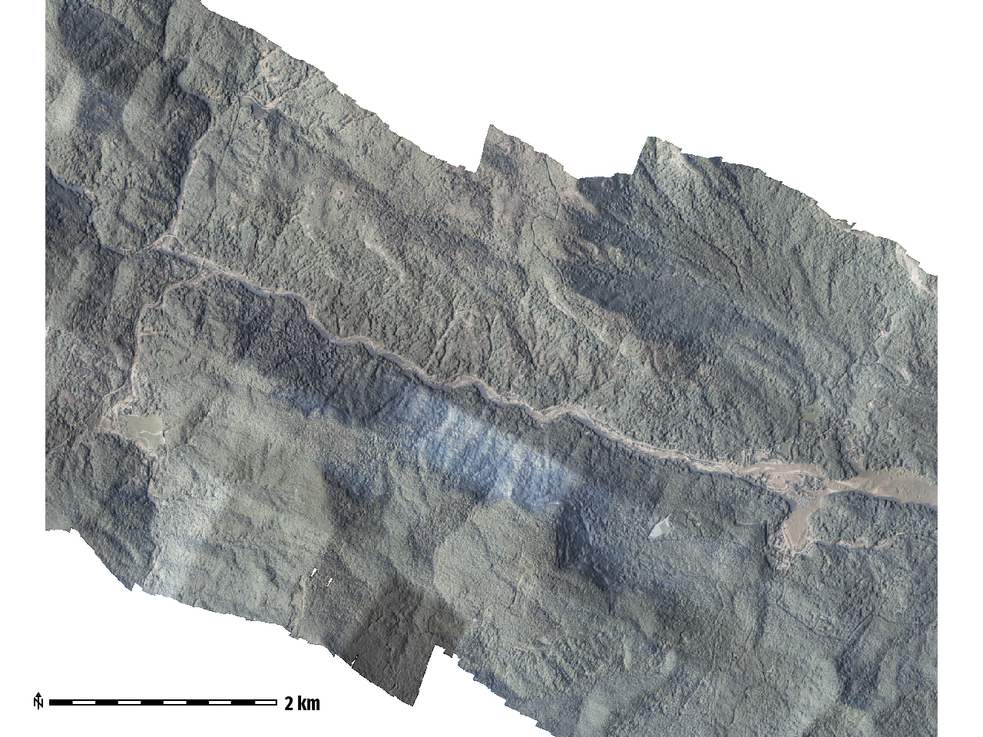
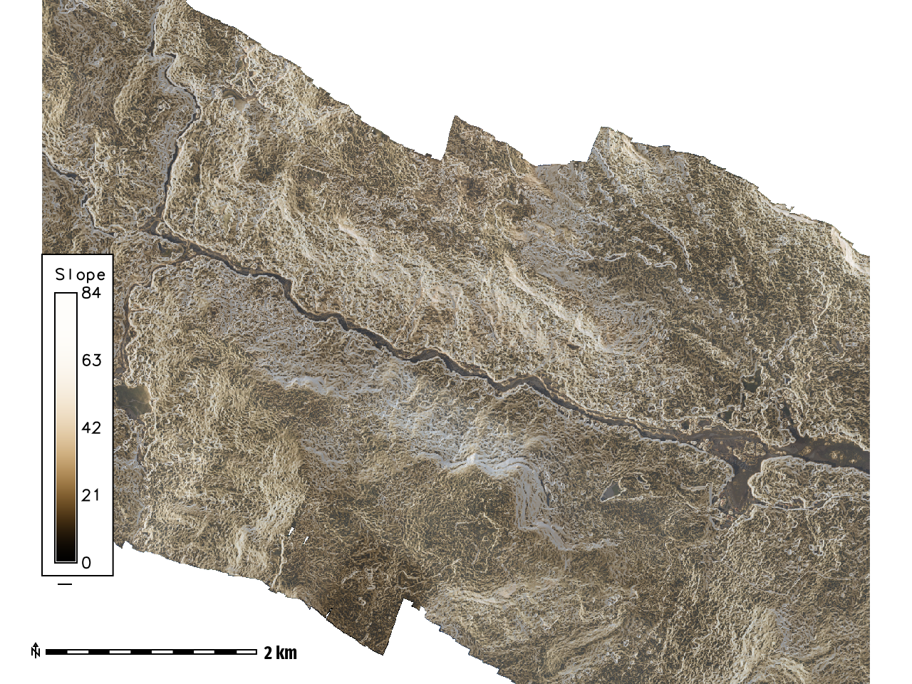
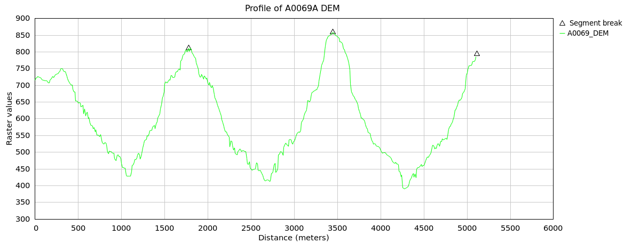
Steep Mountainous Terrain
B
D
A
C
B
C
D
A

Slide 26


Strahler Stream Order
Fluvial geomorphological changes along Brood River
New Stream Channel
(Blue)
2017 NC Streams
(Yellow)

Slide 27



Bearwallow-Chimney Rock - CAP Flight A0069
Bearwallow-Chimney Rock
Lake Lure, NC
Fun Fact
Filming Location
~255m
Debris Damming River

Slide 28

Debris Volume
Estimated at
~28.3 million Cubic
Meters
~11,321
Olympic Swimming
Pools

Slide 29


Bearwallow-Chimney Rock
DSM created using 2024 SfM data
DSM created using 2017 LiDAR data

Slide 30
Lessons Learned
This process revealed several key challenges for rapid post-storm DEM generation, including collecting, storing, and processing large volumes of raw image data. Addressing these challenges is critical for improving workflows and enabling faster deployment of topographic data products for disaster response and recovery.
Processing infrastructure
HPC or Cloud Resources
Data Publishing
DSM
Point Cloud
Mesh
Data Distribution
Mix of online and printed resources

Slide 31
Questions?

Slide 32
References
Andrew B. Hagen, John P. Cangialosi, Marc Chenard, Laura Alaka, Sandy Delgado, 2025. Hurricane Helene (TROPICAL CYCLONE REPORT No. AL092024). NOAA NATIONAL HURRICANE CENTER.
National Geodetic Survey, 2025: 2024 NOAA NGS Emergency Response Imagery: Hurricane Helene, https://www.fisheries.noaa.gov/inport/item/73570.

